Slide 1
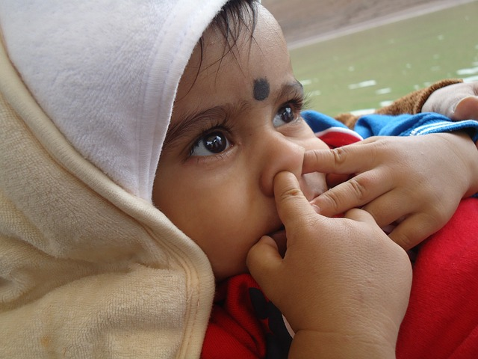
Tiny mouths, big breathes:spotting airway clues in kiddos
Notes:
Title TBD

Slide 2



Boyd Simkins, DDS
Husband, Father, Grandfather
Notes:
Just a quick overview of who I am

Slide 3
Boyd Simkins, DDS
Private practice: Castle Creek Pediatric Dentistry, North Ogden, UT
Faculty, Post-Doctoral Pediatric Residency, Primary Children’s Medical Center, Salt Lake City, UT
Chapter Oral Health Advocate, Utah Chapter American Academy of Pediatrics
Public Policy Advocate, Utah Academy of Pediatric Dentistry
Early Childhood Utah Advisory Council
Continuing Certification Council, American Board of Pediatric Dentistry
President, Committee of Not Being Able to Say I Do Not Have Time
Notes:
Professional life

Slide 4
Disclaimer
I don’t know everything … but I’ll do my best to find out.
No financial conflict of interest to disclose.
Notes:
I will provide my contact information at the end of the slide show

Slide 5
Where we are today?
Complete Health Model
Inflammation
Growth and Development
Airway
Notes:
Go over quickly how each of the aspects play into the practice and the health of the children we are treating
This is the model that oral health should encompass and where our journey has taken us

Slide 6

Learning Objectives
Identify key clinical indicators of potential airway obstruction during dental exams.
Understand the importance of early recognition and its impact on growth and development.
Develop a clear referral pathway and learn how to communicate concerns to caregivers and medical professionals.
Explore the scope of the dentist’s role in monitoring, co-managing, and advocating for pediatric airway health.
Notes:
Course Description:
This lecture will explore the critical role dental professionals play in identifying and managing pediatric patients with potential upper airway concerns. Participants will learn how to recognize clinical signs and symptoms during routine dental examinations that may indicate airway issues such as mouth breathing, snoring, or sleep-disordered breathing. The course will also cover appropriate referral protocols and interdisciplinary collaboration with medical providers, including ENTs, pediatricians, and sleep specialists. Emphasis will be placed on the importance of early detection and the dentist’s role in ongoing care, education, and, when appropriate, intervention strategies to support optimal airway development in children.
Learning Objectives:
Identify key clinical indicators of potential airway obstruction during dental exams.
Understand the importance of early recognition and its impact on growth and development.
Develop a clear referral pathway and learn how to communicate concerns to caregivers and medical professionals.
Explore the scope of the dentist’s role in monitoring, co-managing, and advocating for pediatric airway health.

Slide 7
What is oral health
Definition from World Health Organization:
Oral health is the state of the mouth, teeth and orofacial structures that enables individuals to perform essential functions such as eating, breathing and speaking, and encompasses psychosocial dimensions such as self-confidence, well-being and the ability to socialize and work without pain, discomfort and embarrassment.
www.who.int/health-topics/oral-health/#tab=tab_1
Notes:
Before we go further, let’s at least try to define Oral Health.
Do we find that this definition is too generic? There is a wide variety of what people would call normal and healthy?

Slide 8

What is oral health
Do we consider Growth and Development in this definition?
“The interrelation of malocclusion, oral and general health should be taught in dental education such as malocclusion and periodontitis or caries and potential for traumatic damage of teeth and airway obstruction with all consequences.”
Enzo B. Malocclusion in orthodontics and oral health: Adopted by the General Assembly: September 2019, San Francisco, United States of America. Int Dent J. 2020 Feb;70(1):11-12. doi: 10.1111/idj.12554. PMID: 31985819; PMCID: PMC9379163.
Notes:
This person may feel that they fit the definition of “oral health”. Would we agree?
This is just one facet of the policy on malocclusion that was created as a supplement to the WHO definition of oral health.
Perception is reality when we do not know ideal?

Slide 9

What risk do we assess in dentistry?
Notes:
Dentistry is about risk assessment.

Slide 10
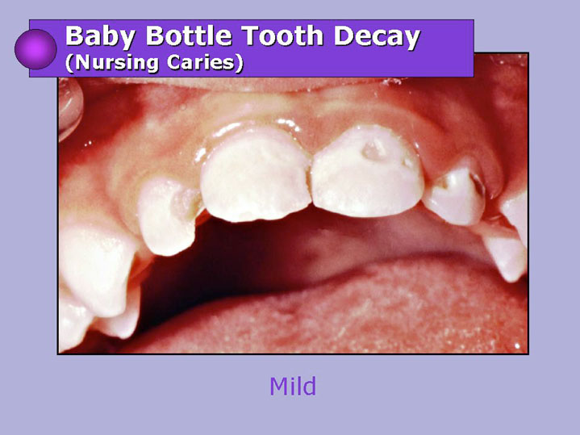
Early Childhood Caries(ECC)
Numerous studies document that ECC predicts future caries often in spite of prevention
Courtesy Dr. Paul Casamassimo
Notes:
This has been my bread and butter as a pediatric dentist
Why are we concerned about early childhood caries and risk assessment?
Significant health concerns that come with this.
Pain, infection, Failure to Thrive
Societal cost

Slide 11
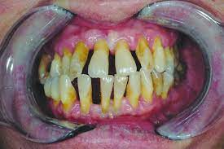
Periodontal Disease
Notes:
How about Perio.
This is part of why I went into pediatrics. The three “P’s” Perio, Prosth and Pedo
Inflammation in the mouth, the gateway to the body.
Half of adults by age 30 have Perio.

Slide 12
Periodontal Disease
Gingival color change and swelling appear to be more common expressions of gingivitis in children than are bleeding and increased pocket depth
Excessive overjet and overbite, nasal obstruction, mouth breathing habit, partially exfoliated, loose deciduous, malposed, eroded margins of partially resorbed and carious teeth can frequently cause gingivitis.
Pari A, Ilango P, Subbareddy V, Katamreddy V, Parthasarthy H. Gingival diseases in childhood - a review. J Clin Diagn Res. 2014 Oct;8(10):ZE01-4. doi: 10.7860/JCDR/2014/9004.4957. Epub 2014 Oct 20. PMID: 25478471; PMCID: PMC4253289.
Notes:
Nasal obstruction, mouth breathing. What came first, chicken or the egg?
Review change at dental school

Slide 13
“The interrelation of malocclusion, oral and general health should be taught in dental education such as malocclusion and periodontitis or caries and potential for traumatic damage of teeth and airway obstruction with all consequences.”
What risk?
1. Dental Caries
2. Periodontal disease
3. Airway
Notes:
Let’s go back to the definition with the WHO and principles on malocclusion with the FDI.
So, is the third risk assessment airway?
I am sure we could add more, but could we sustainably do that? I am stretched already in my office.

Slide 14

What risk?
3. Airway
Growth and development
Obstructive Sleep Apnea Syndrome (OSAS)
Sleep Related Breathing Disorder (SRBD)
Sleep questionnaires
PSQ
SRBD subscale
SDIS
STOP-BANG
Epworth
List goes on ……..
KISS
“Keep it simple ….. Doctor”
Notes:
With Airway as the third risk assessment how do we communicate this to the parents?
I’ve seen the glazed look when we talk to parents about airway in a dental office. (Briefly discuss my journey)
Can we get more traction with growth and development? I know I can predict with high certainty if a child will have malocclusion without intervention and airway is now part of that conversation.
In the beginning I started hardcore with airway conversation only
Sleep apnea
ADD symptoms, permanent mental damage
“Is my child going to die” “I am really angry that you are scaring me” – Mom of a childhood cancer survivor that I met in my office
Never came back
How do we soften the blow
Crowded teeth
Malocclusion
Mouth breathing
Tonsils/adenoids
Underdevelopment lateral and A/P
vertical growth pattern
Sleep
What can we use as objective research backed questionnaires? We can relate this to Caries and Perio risk!
With parents you do not need to overcomplicate. Meet them on the level they expect (know your audience)

Slide 15

Dentists can and do play an essential role in the multidisciplinary care of patients with certain sleep related breathing disorders and are well positioned to identify patients at greater risk of SRBD.
American Dental Association: Policy Statement on the Role of Dentistry in the Treatment of Sleep Related Breathing Disorders (Trans.2017:269; 2019:270)
Notes:
The ADA seems to think that Airway is important (Thanks Steve)

Slide 16

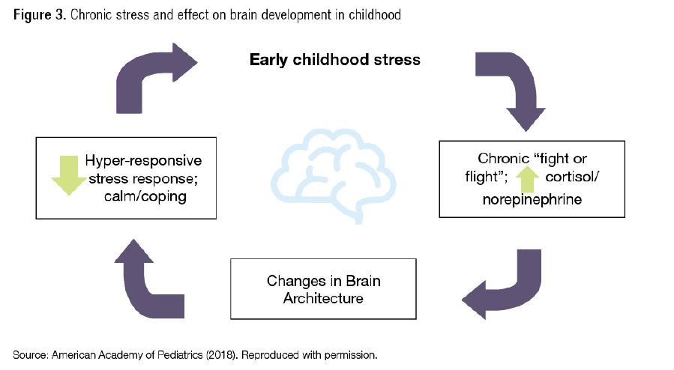
National Institutes of Health. Oral Health in America: Advances and Challenges. Bethesda, MD: US Department of Health and Human Services, National Institutes of Health, National Institute of Dental and Craniofacial Research, 2021
Notes:
For those interested in sympathetic tone.
How “stress” or constant sympathetic tone affects children
Liu YZ, Wang YX, Jiang CL. Inflammation: The Common Pathway of Stress-Related Diseases. Front Hum Neurosci. 2017 Jun 20;11:316. doi: 10.3389/fnhum.2017.00316. PMID: 28676747; PMCID: PMC5476783.
“Therefore, we suggested that inflammation may be the common pathway for stress-related diseases, which may act as a factor that contributes disease progression or may occur very early during the development of the disease.”
Airway and sympathetic tone conversation?
You will have some parents that come in who are aware of this, but those are the exception and not the rule.

Slide 17
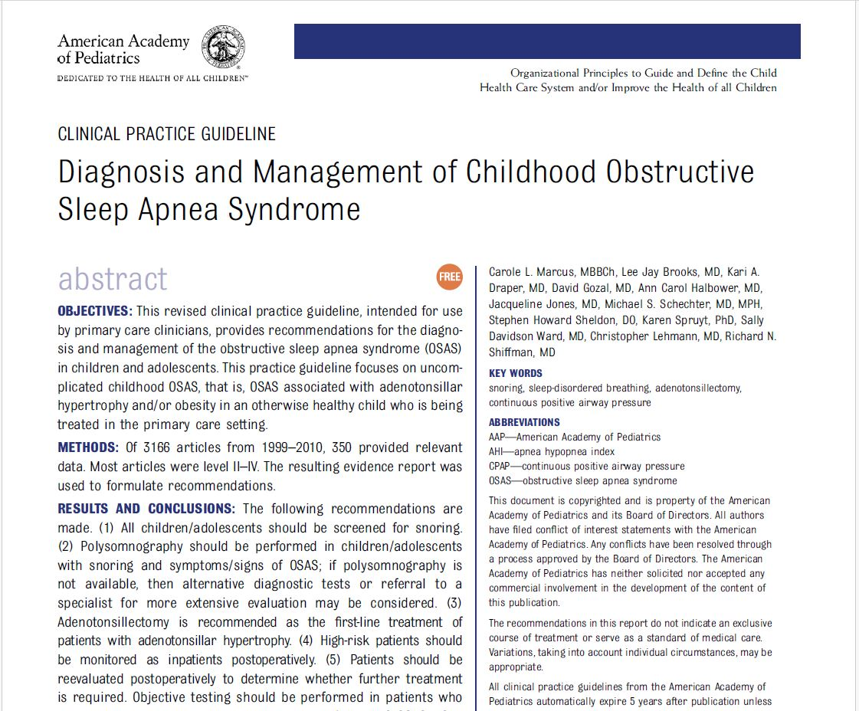
Notes:
What is the recommendation from AAP for management/referral?

Slide 18
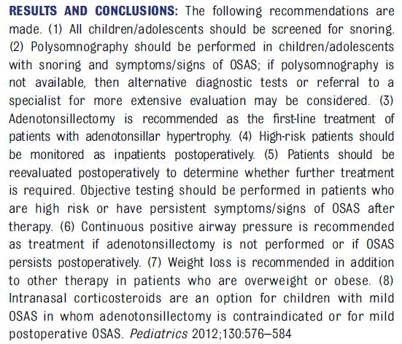
Notes:
Do I need to highlight all the things?

Slide 19

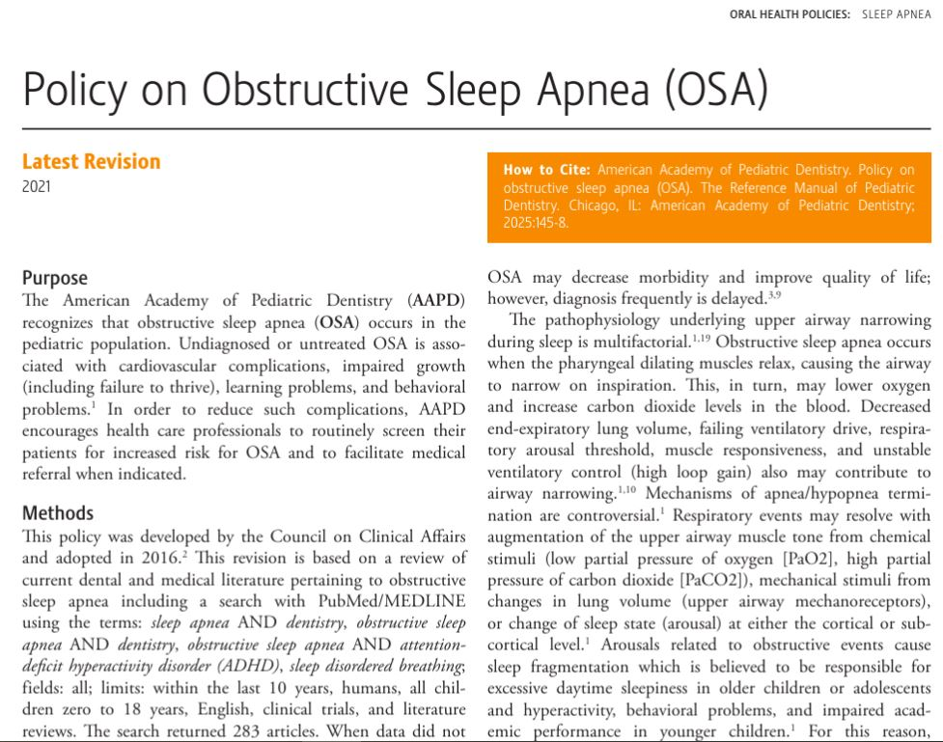
Notes:
AAPD recommendations

Slide 20
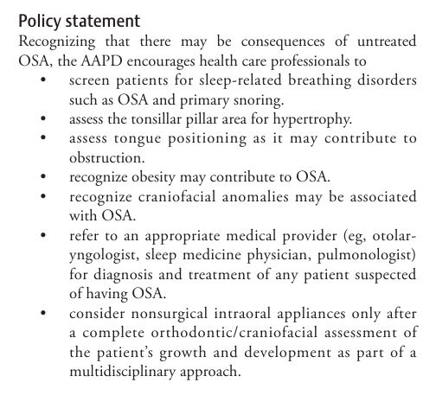
Notes:
AAPD recommendations

Slide 21
Pediatric Airway “Risk” Assessment
Notes:
The AAPD has an “airway” risk assessment form.
This is for sedation as well as sleep airway and it covers a lot of the things that put children at risk for SRBD
This is still in our reference manual! How many practitioners actually use it?
Do we know what we are looking for?
How do we correlate our clinical findings and communicate that to parents, physicians, etc.

Slide 22
Pediatric Sleep Questionnaire:
Sleep-Disordered Breathing Subscale
Notes:
What are we able to use when communicating with the medical world?
This was given to me by the director of the sleep clinic at the Children’s Hospital in Salt Lake City
Her opinion was that it was the most accurate along with the PSQ, and acknowledged that there really aren’t any great ones out there.
You may have to dig a little find what you can use to communicate with the medical world around you.
Let’s compare the two and see where we can fit this into screening and communicating this to your families

Slide 23

Notes:
What we can see from this comparison is that there is a lot of crossover.
In fact the Pediatric Airway Assessment actually covers all of the items on the SRBD subscale. The only difference is that with the SRBD there is a scoring system that can be useful when communicating to the PCP or ENT, etc.
The only question not specifically on the PAA is “Did your child stop growing at a normal rate at any time since birth?”

Slide 24
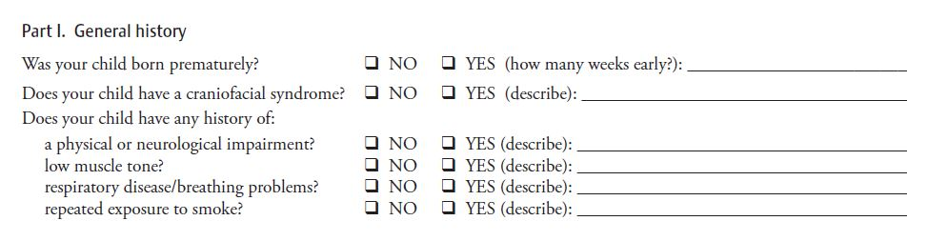
Notes:
Quick general history.
Why would some of these questions matter?

Slide 25

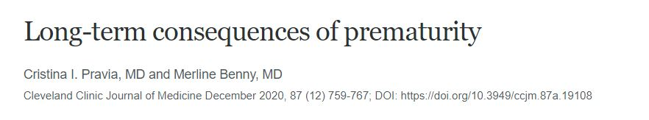
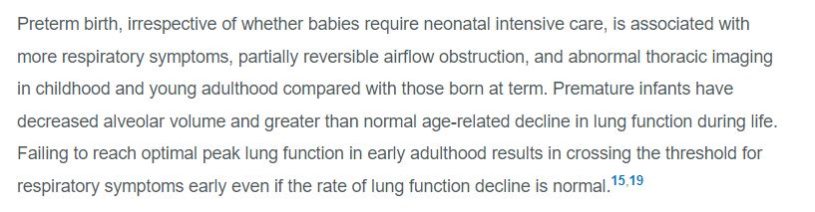
Notes:
I always wondered why that was there

Slide 26
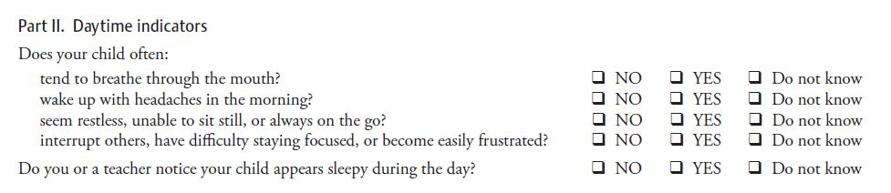
Notes:
Let’s go through the PAA because it has great clinical things we see everyday that put the children at risk.
What does that sound like? ADD

Slide 27
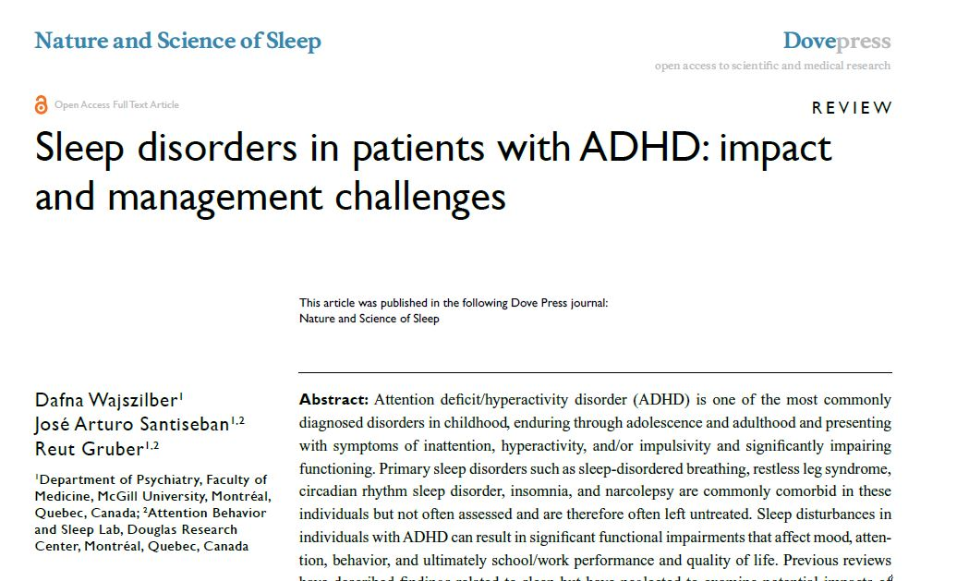
Notes:
How many parents would jump at the chance for possibly a 1 in 2 shot to help their child showing these symptoms.
I’ve heard it many times that Steve Sheldon, who ran the sleep clinic in Chicago said he felt it was 100%

Slide 28
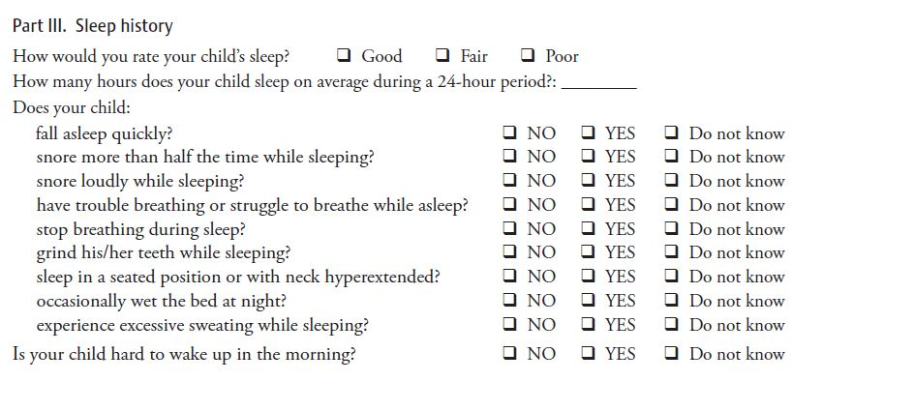
Notes:
Simple screening questions that have been around for a long time.
None of these behaviors are normal.
With the SRBD subscale, once you hit 33% yes answers, the directions are to refer for evaluation.
One thing I have noticed is that many parents have no idea how their children sleep.
I actually ask parents to set an alarm for 2-3 times one night to check on their children and their sleep quality when I see the furrowed brow.
I also love when the parent says they sleep like a brick. That must be great sleep right? Explain subarousals?

Slide 29
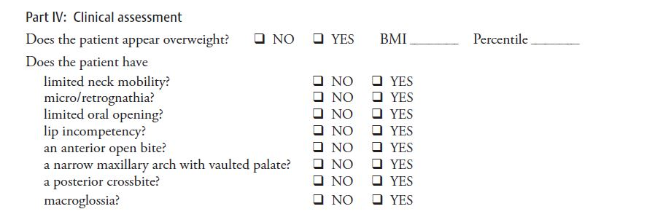
Notes:
Overall appearance
How about looking in the mouth?

Slide 30
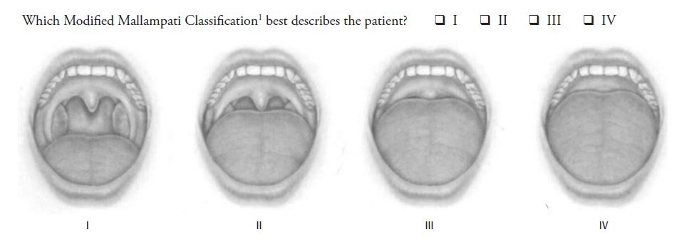
Notes:
Mallampati is generally used for difficulty of intubation. It I also a relative indicator of tongue size to mouth size.
How much space do you need to breathe?

Slide 31
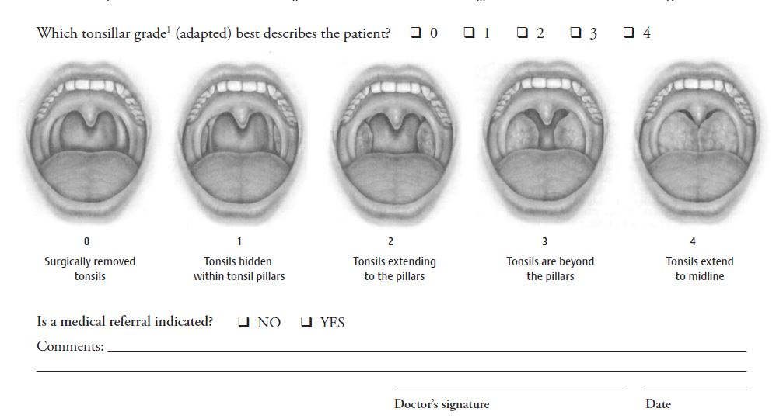
Notes:
How about Brodsky score. This is easy to relate to parents and physicians.
How simple is the medical referral question at the bottom.
We use both in our office to one extent or another. This way we can be thorough and at the same time communicate with our medical colleagues if necessary.
When I feel there is a referral needed. I will often refer to the 33% threshold of the SRBD subscale. Most physicians will acknowledge this and start the ball rolling.
For some of my parents, once the PCP is on board then they will start listening.
I also have no problem going straight to the ENT. I have some that we have established great relationships

Slide 32
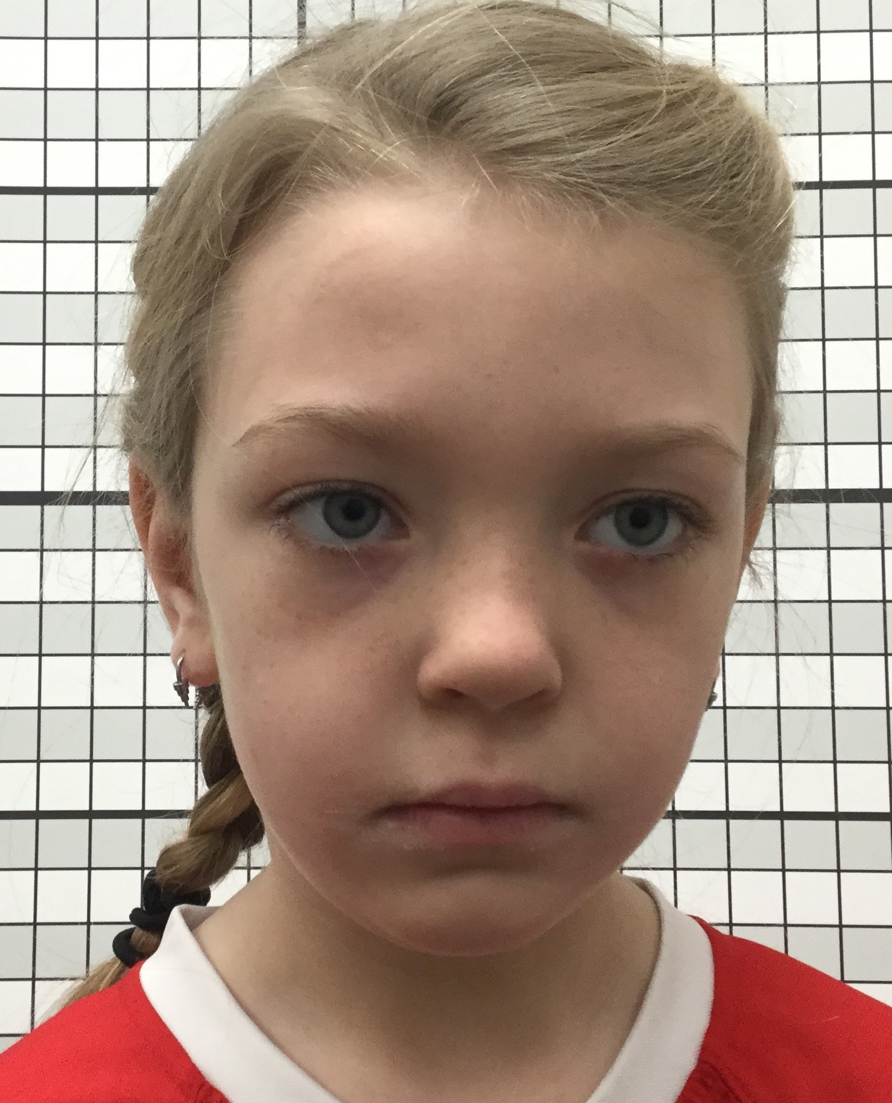
Notes:
Let’s go through some pictures to see what we are talking about with the clinical signs.
What do we see in this picture?
What are clinical signs that tip us off that there are issues?
Just look at the low hanging fruit
Eyes? – Venous pooling
What facial type do we have? Dolichocephalic
Sclera present below iris (maxillary deficiency)

Slide 33
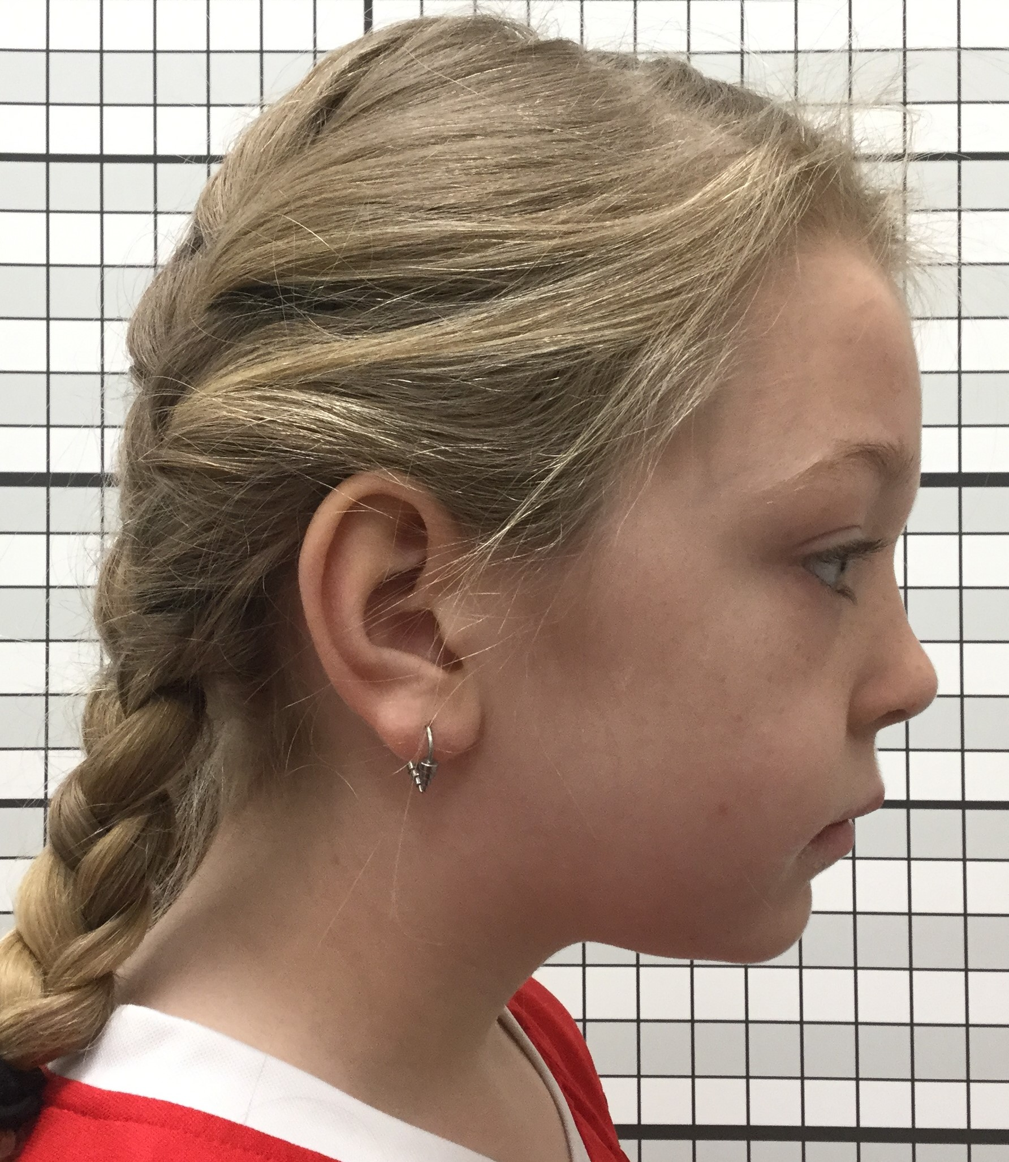
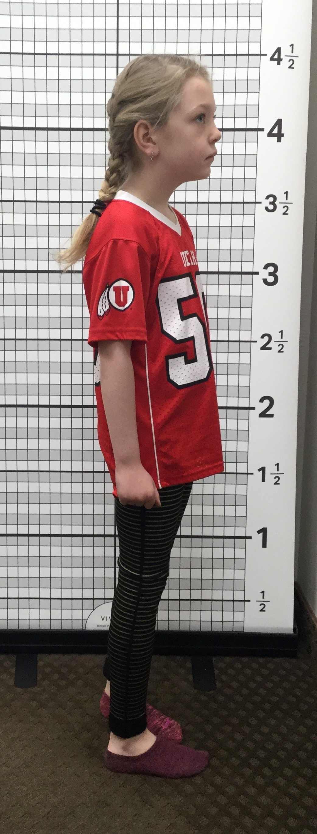
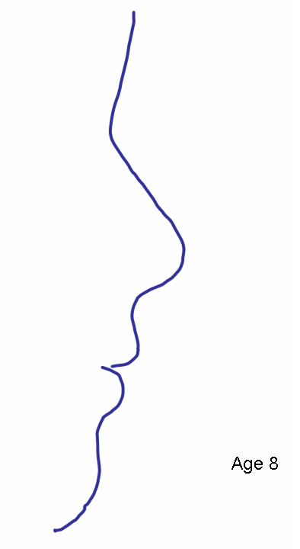
Examples – pictures are more fun anyway!
Notes:
What do we see in this picture?
Submandibular pannus? What does that signify?
Where does the chin position sit? Bolton?
Convex?
Let’s Zoom out
Posture? Forward head position? Cervical tilt?
Would we consider this child healthy?
What does this mouth look like? Any guesses?

Slide 34
Notes:
We scored this particular child a 3
No wonder we see protrusion out the bottom

Slide 35
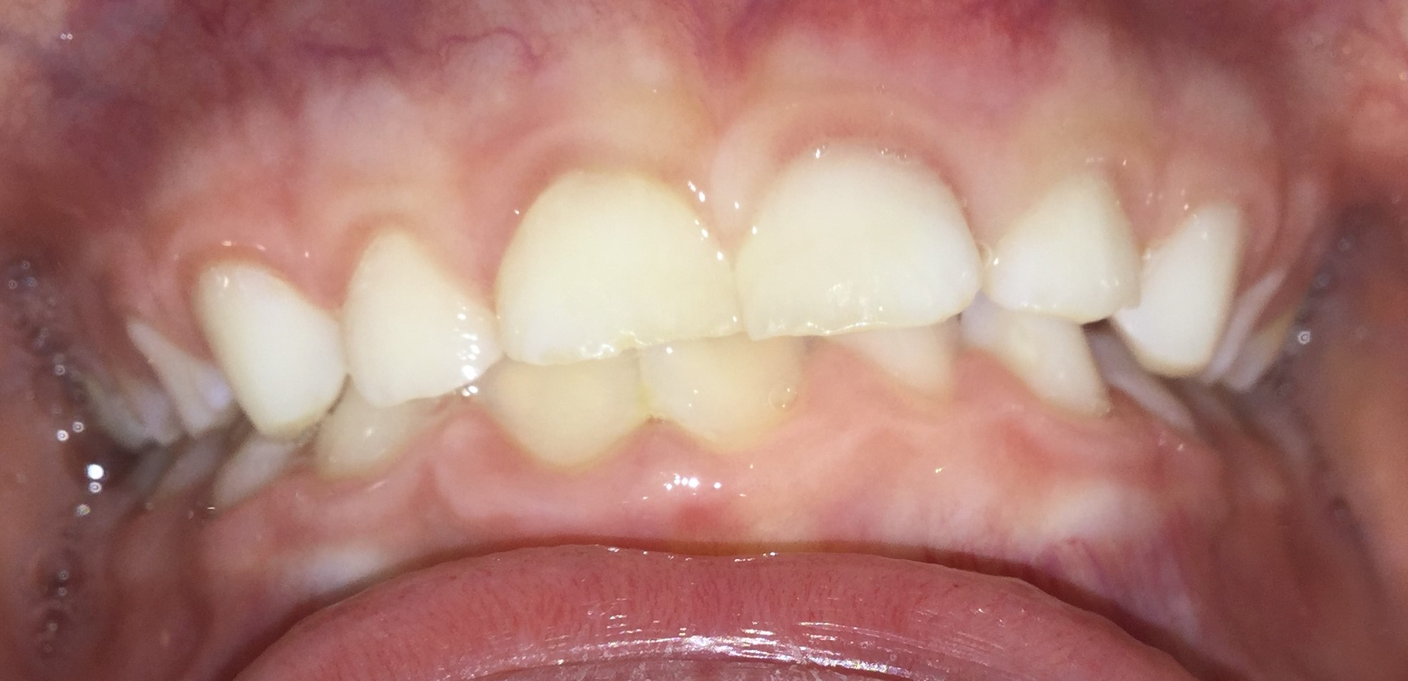
Examples – pictures are more fun anyway!
Notes:
This is where we shine right?
How do we feel about spacing?
Are molars upright?
Can we predict what is going to happen in this mouth?

Slide 36
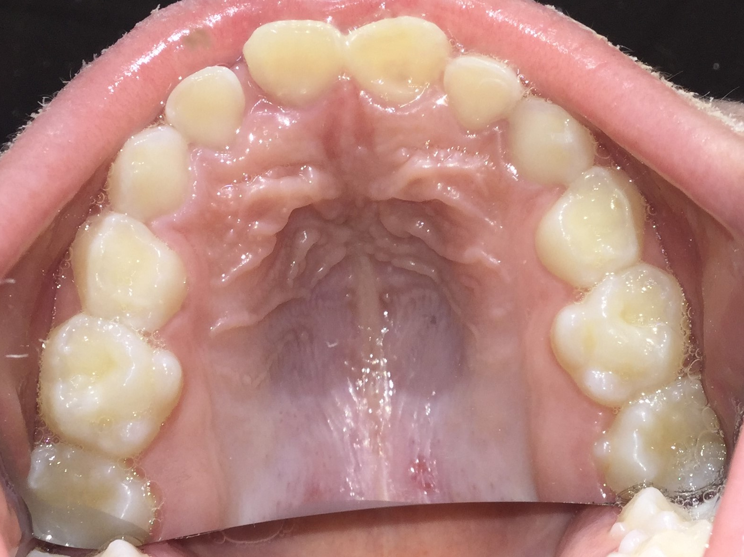

Notes:
How do we feel about the shape of the palate? Pretty sure that will fit great, just no history of thumb sucking
Just like our AAPD screening tool, Narrow arched maxillary palate. Do we see some wear? Bruxing?

Slide 37
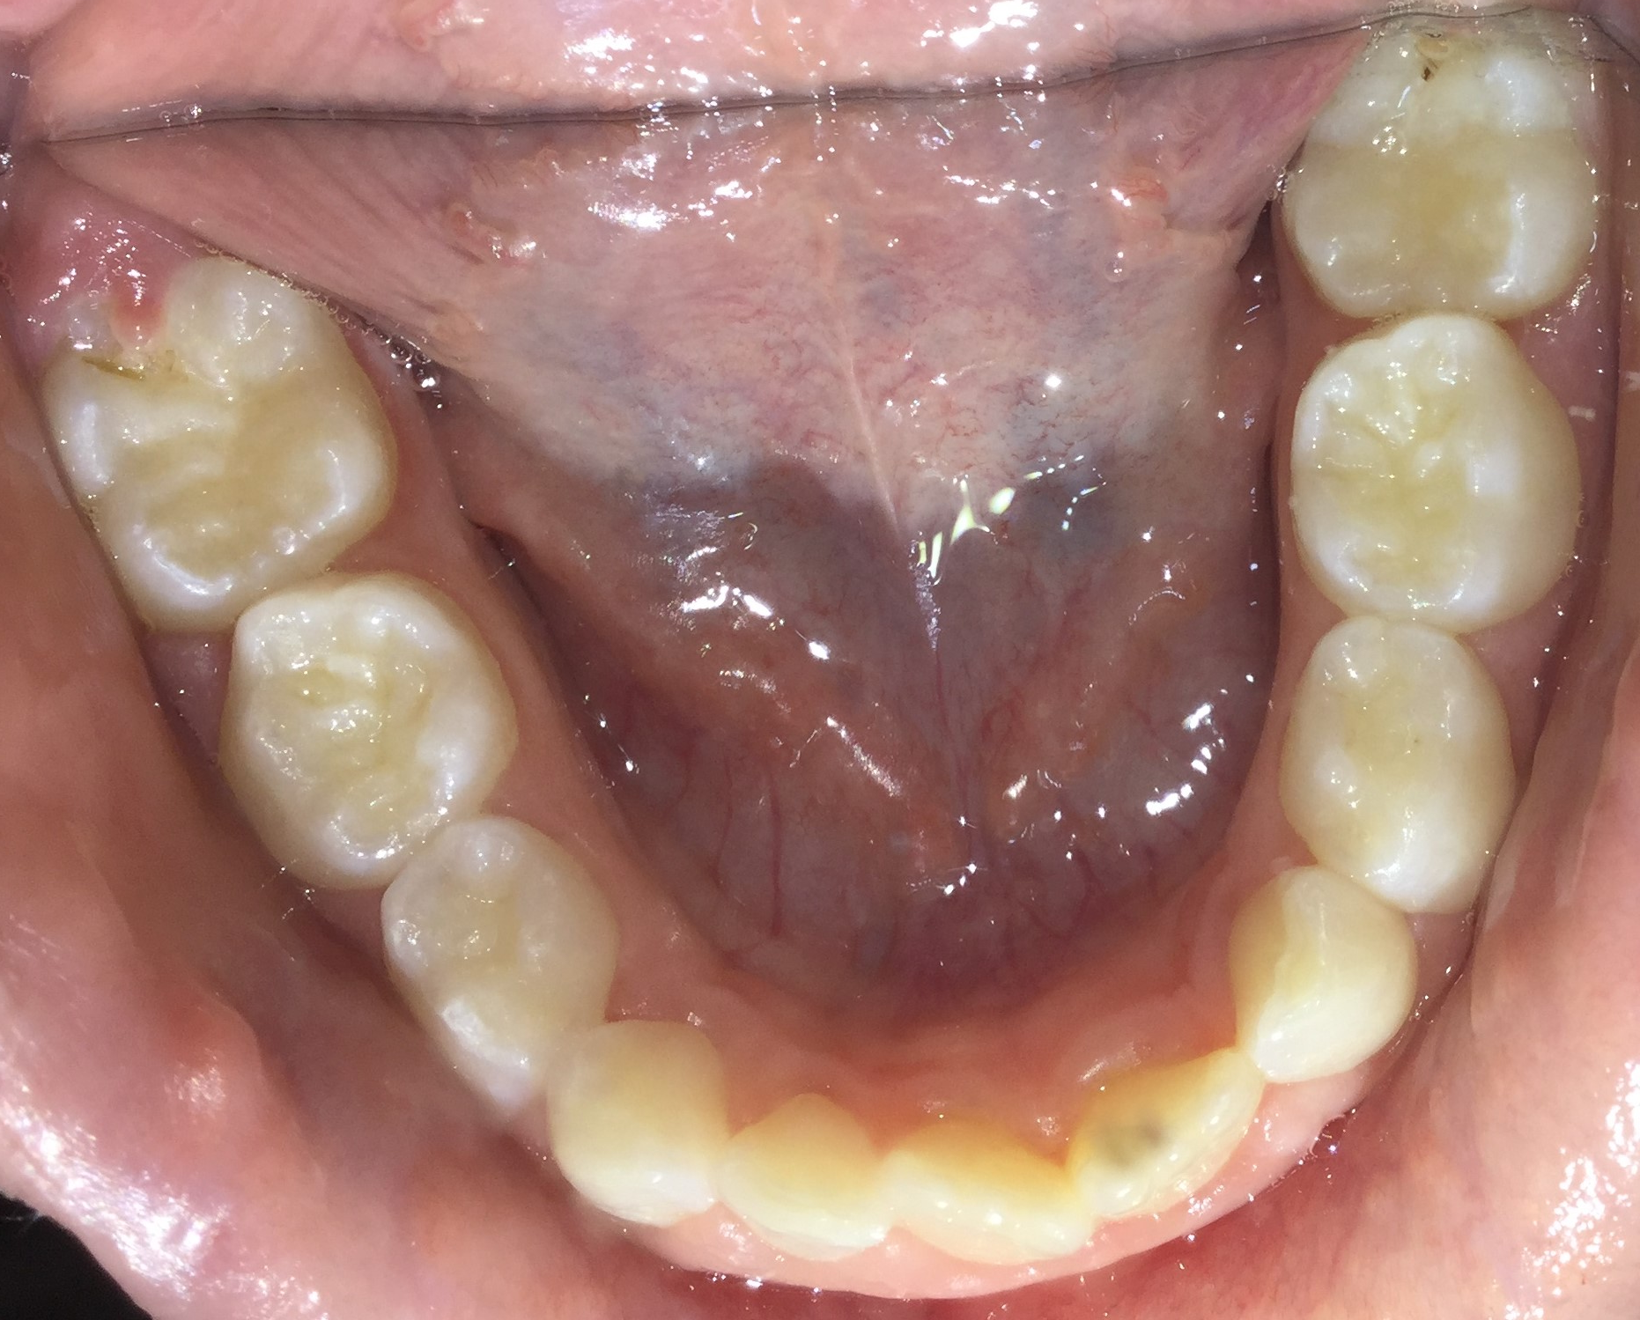
Notes:
Lost three to get two (so common)
Is there going to be crowding? Can we predict that?
Let’s do a side by side to see if we were right on our predictions.

Slide 38
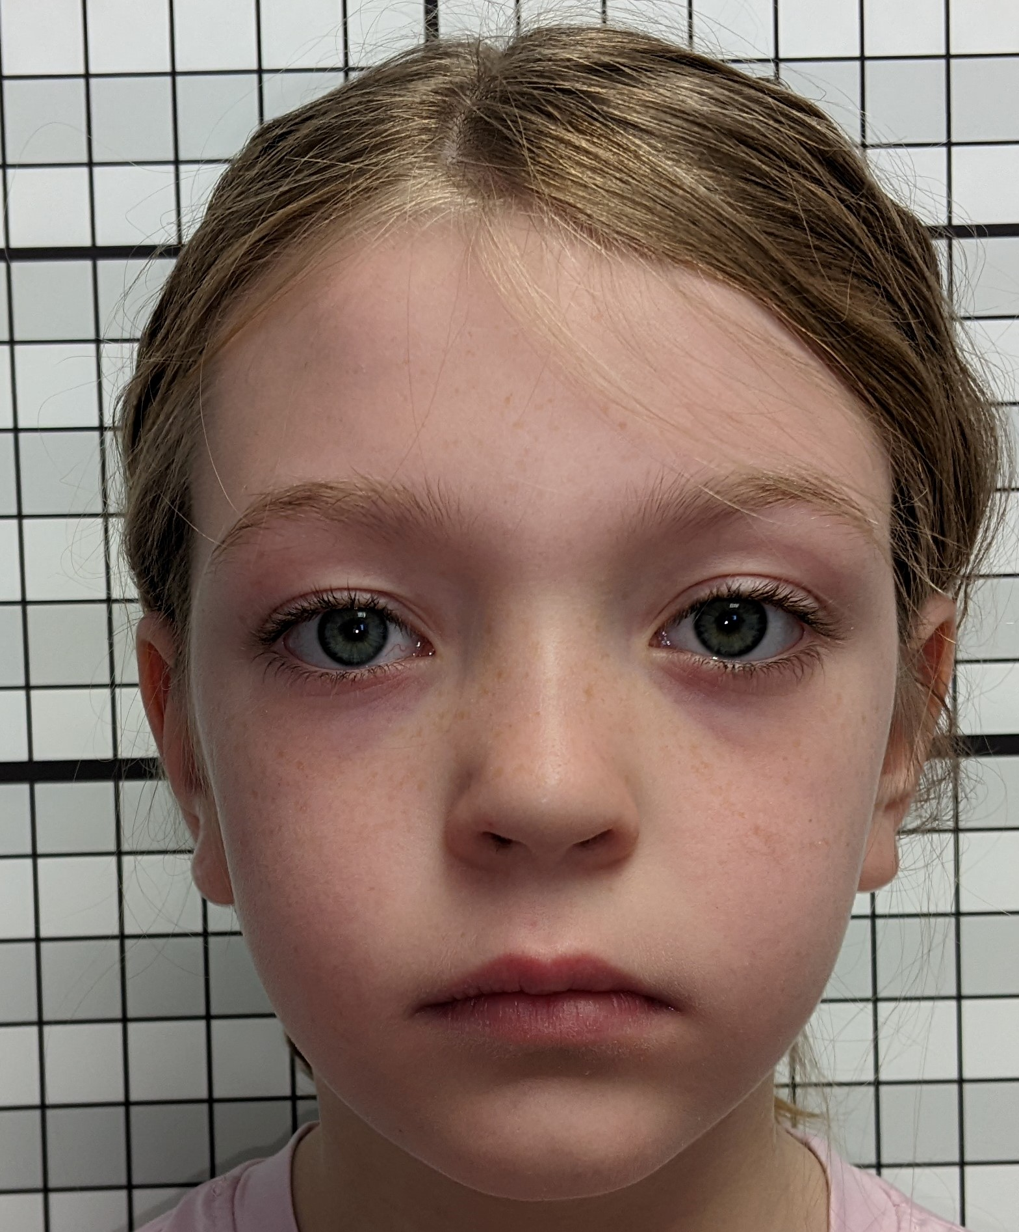
Notes:
First pictures are from 4/22, second from 8/23 (16 months)
Changes?
Fairly similar frontal look.
Sclera still present
Venous pooling
Dolichocephalic

Slide 39
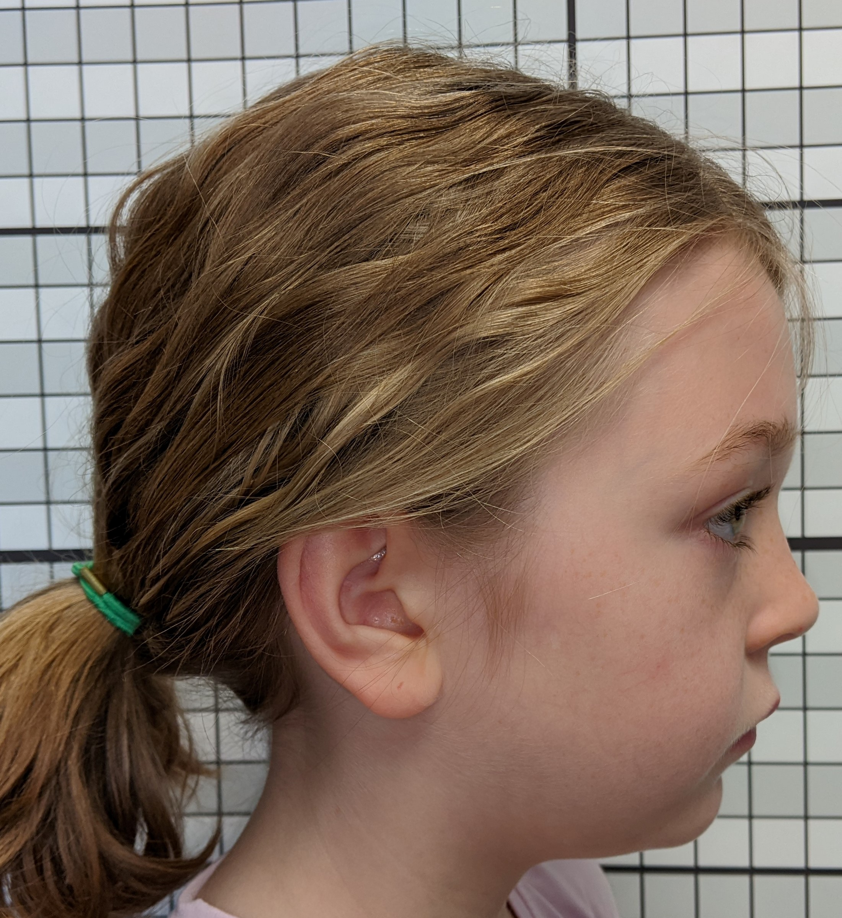
Notes:
Changes? Other than hair style.
How do we feel about growth pattern on this child? Submandibular pannus?
How is convexity improving?

Slide 40
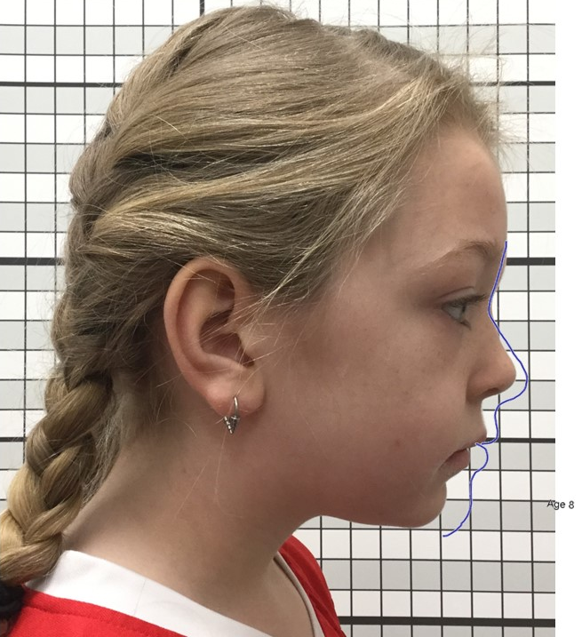
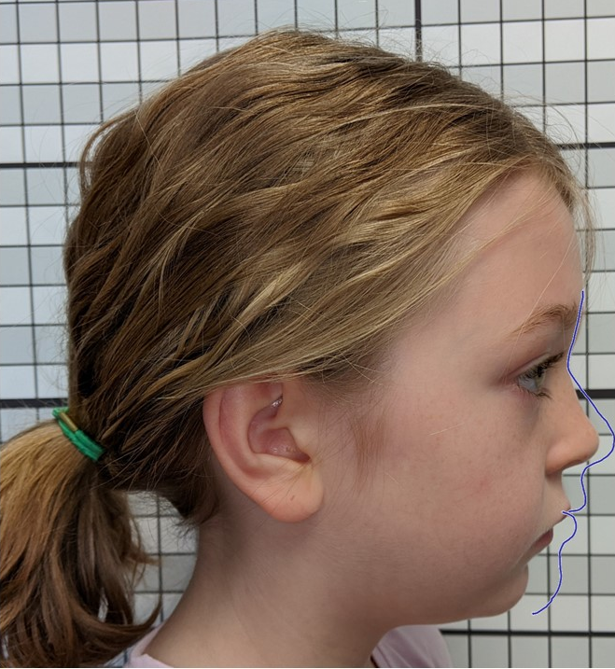
Notes:
How about the Bolton – not catching up

Slide 41
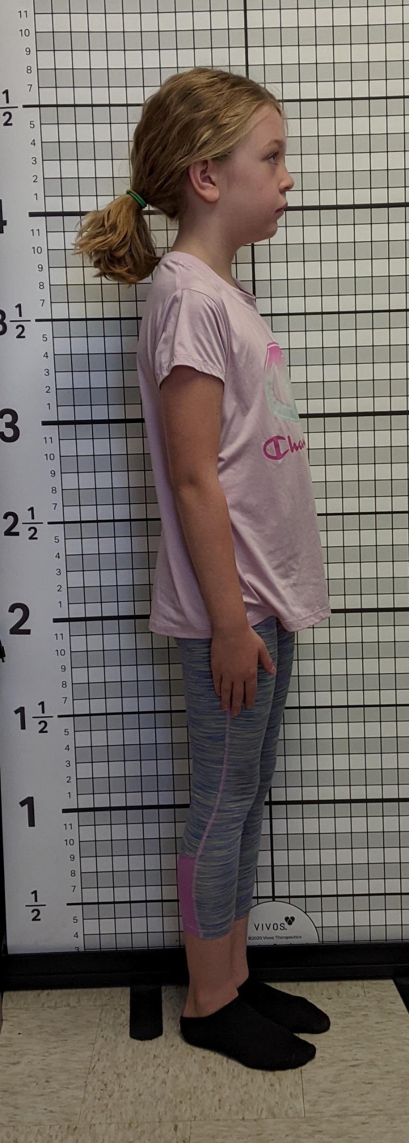
Notes:
How about posture?
Less forward head posture or are we protruding out abdomen to compensate?

Slide 42
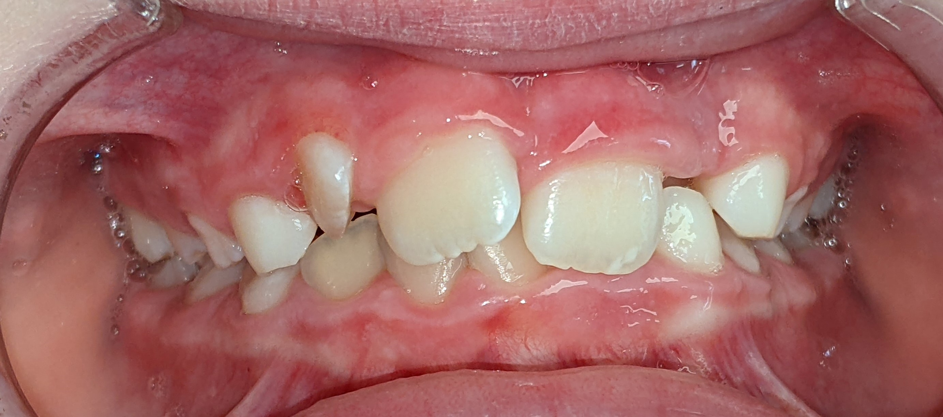
Examples – pictures are more fun anyway!
Notes:
Drumroll please!
Did we predict well?
Definitely did not get better!

Slide 43
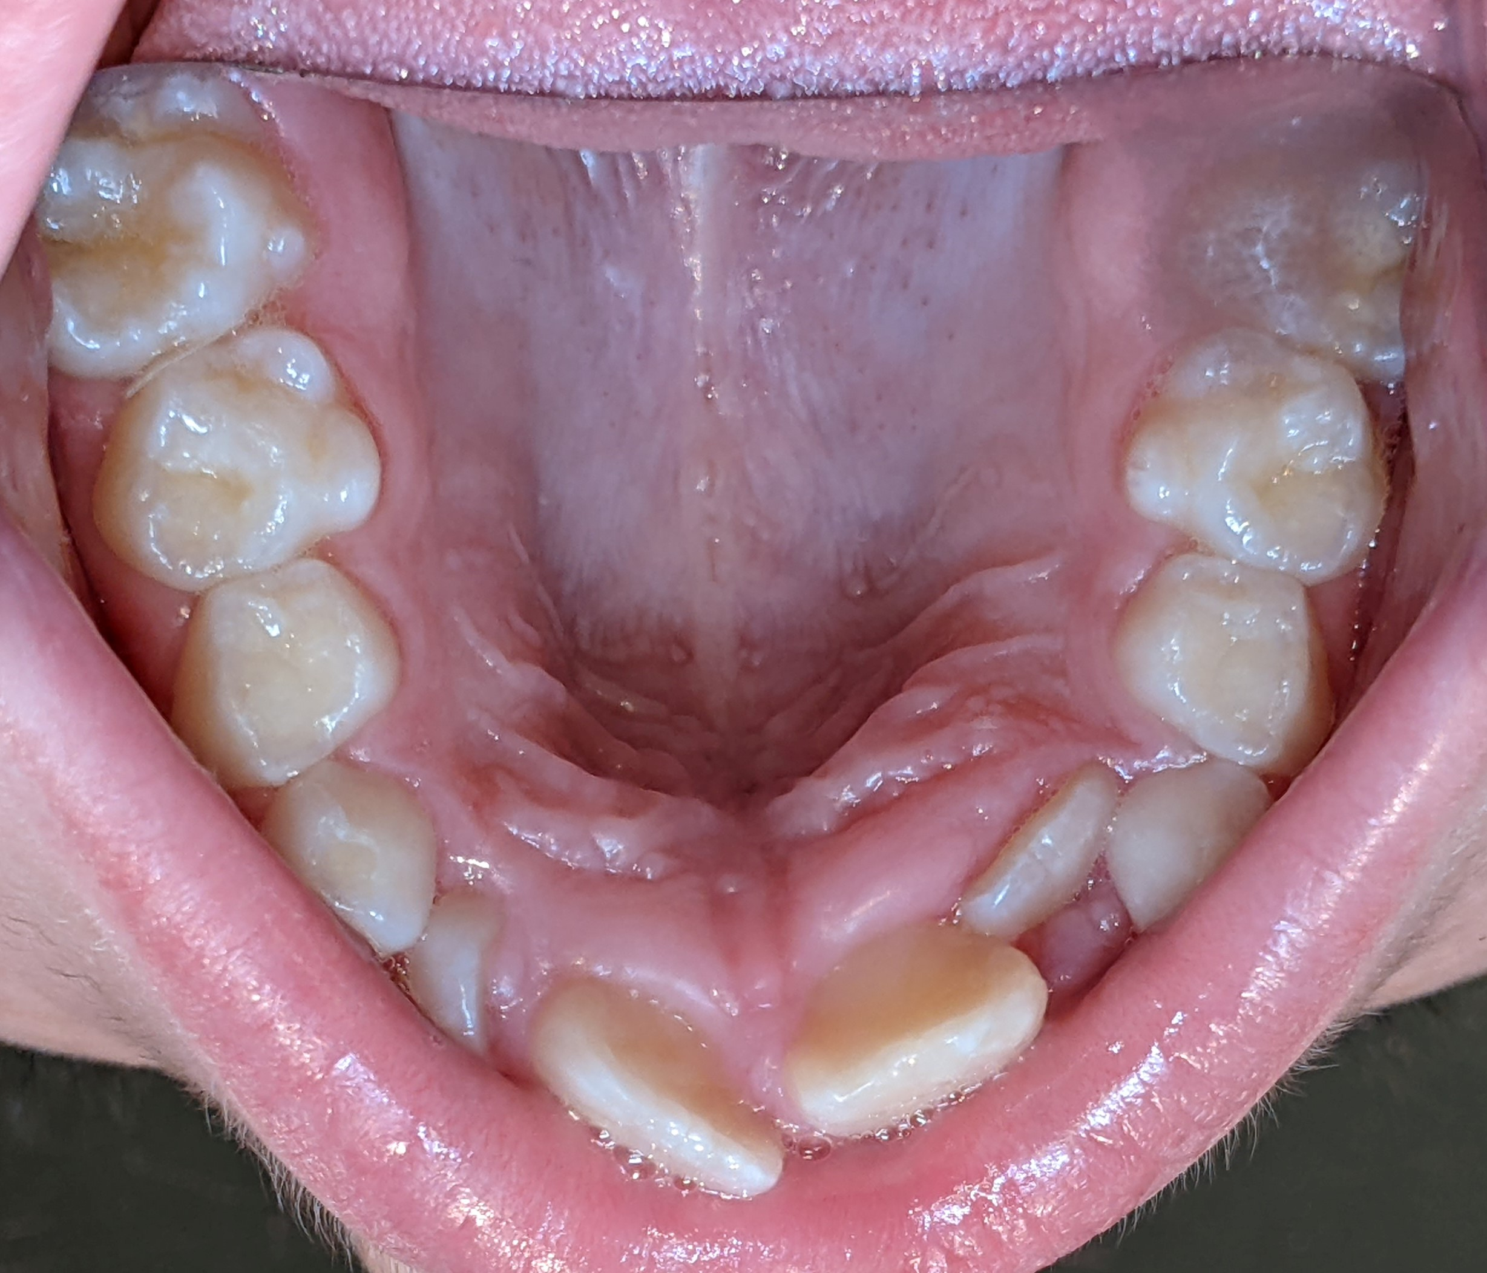

Examples – pictures are more fun anyway!
Notes:
No words
How many times does the parent marvel that we were able to predict this?
Dental Super powers?

Slide 44
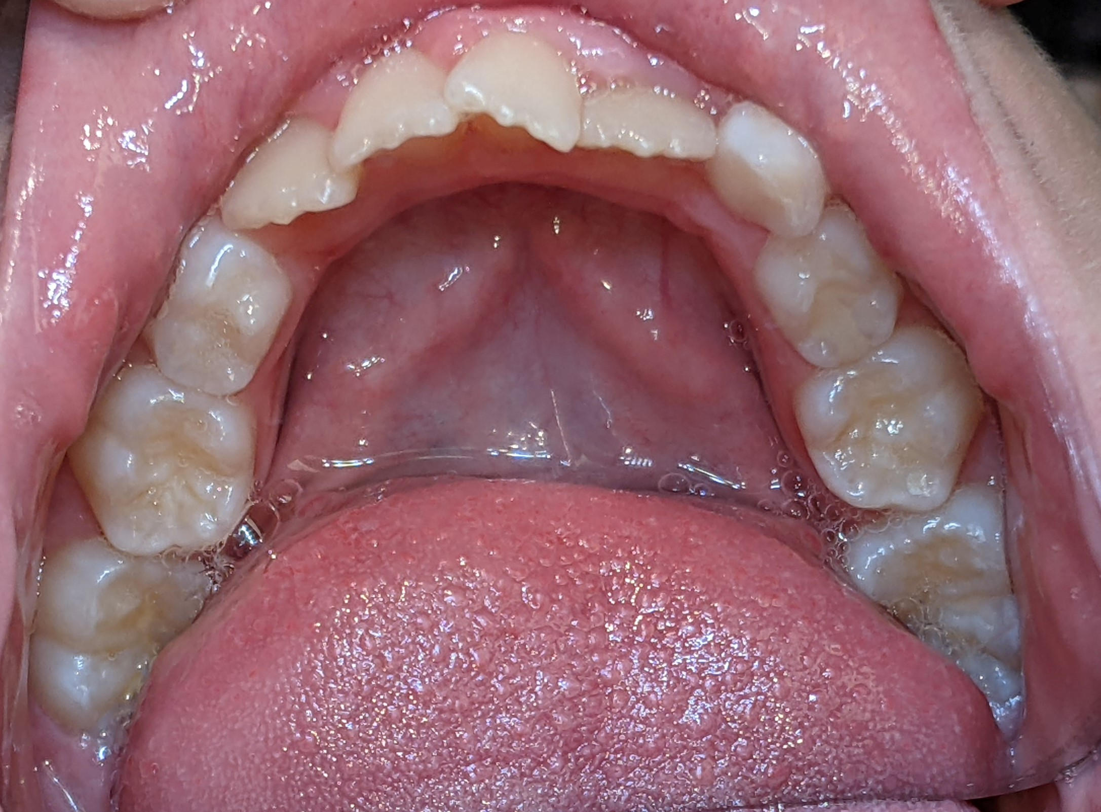
Examples – pictures are more fun anyway!
Notes:
Spontaneous space showing up?
Classic lose 5 to get 4 situation
Did we know this was coming?

Slide 45
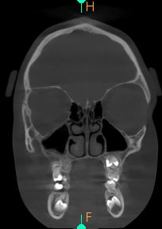
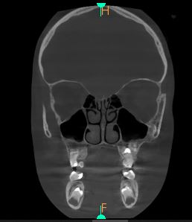
Notes:
Concha, showing narrowest constriction in nose in both
Worse, better, same?

Slide 46
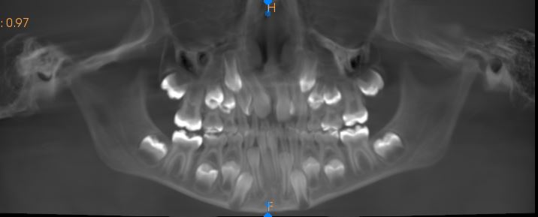
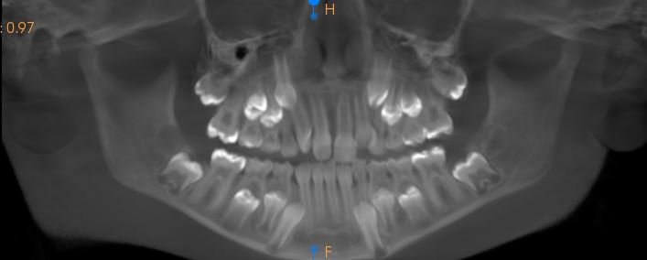
Notes:
Pan
Could we predict this?
In-bone crowding
Tight squeeze

Slide 47
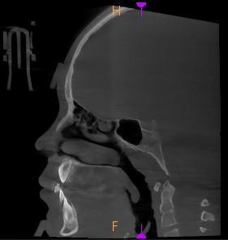
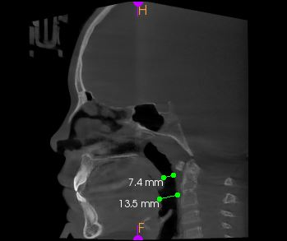
Notes:
Profile
Does the airway look better?
Small difference in position in the machine we have to account for?
Tilt of the head?
Mimics the change in the body posture?

Slide 48
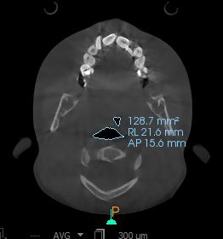
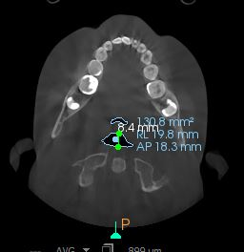
Notes:
Retropalatal – narrowest point
Not better for sure
Under 10 mm A/P is compromised

Slide 49
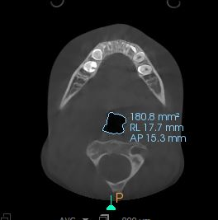
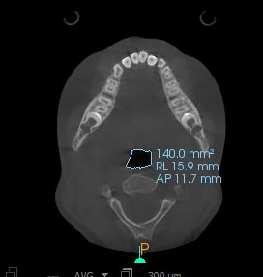
Notes:
Retro lingual
Change? Worse?

Slide 50
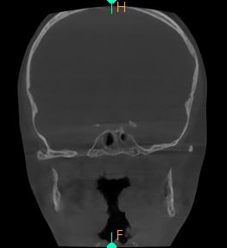
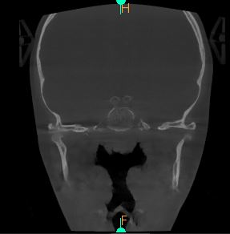
Notes:
Tonsil. Not “growing” into this issue

Slide 51
Notes:
Where would we put those tonsils?
We scored her a 3 clinically

Slide 52
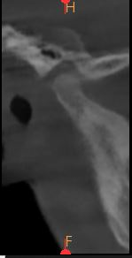
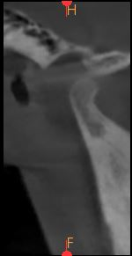
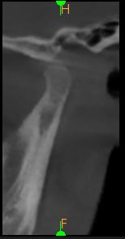
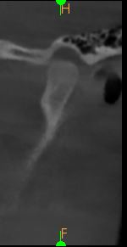
Notes:
TMJ
What is happening to the condyle!
What is that going to do that airway? 5+ mm forward posturing (Middle two are from the second CT)

Slide 53
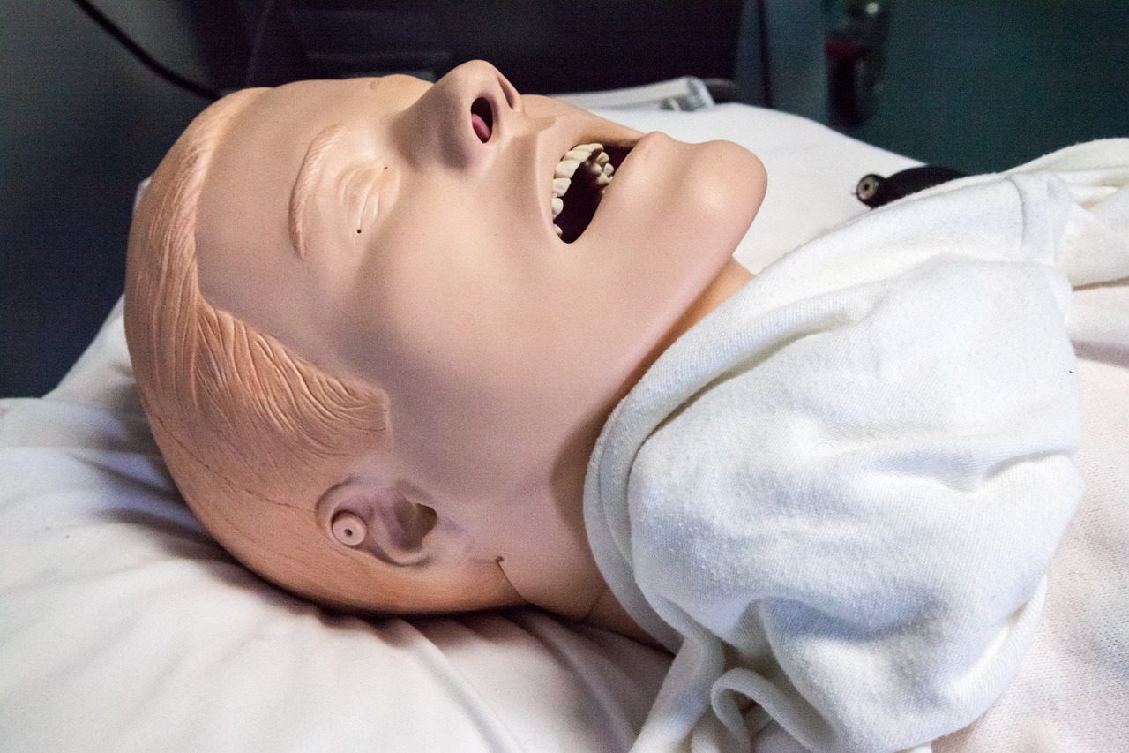
Notes:
Imagine this mandible 4-5 mm retruded. She essentially did a jaw thrust maneuver
Look familiar
What does that say about the airway?

Slide 54
Notes:
This is how she scored

Slide 55
Some snoring

Slide 56
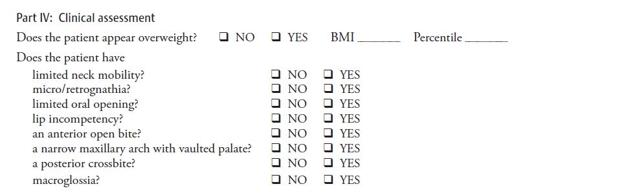

Slide 57


Notes:
I did not communicate well with mom about sleep or about growth and development. She suffered because of this.
Luckily we are in treatment now
(waiting for updated material to insert)

Slide 58

Notes:
We are playing catchup now.
Latest.
Getting closer

Slide 59

Notes:
Maybe a bit better
Let’s move on.

Slide 60

Notes:
Latest photos

Slide 61

Notes:
Maybe a bit better
Let’s move on.

Slide 62


Notes:
Very different from initial assessments. Awareness with parents increases dramatically. This is where we continue with providers such as ENT, Myofunctional therapist, allergist, etc. to seek resolution of as much as possible

Slide 63


Notes:
What are we seeing here?
Venous pooling. A little tougher given skin pigmentation
Mentalis strain
Excess gingival show
Upper labial groove
Sclera present

Slide 64


Notes:
Tongue (submandibular pannus)
This is where development should be at age 8

Slide 65


Notes:
What are we seeing here?
Head tilt (muscular?)
Forward head position

Slide 66


Notes:
What are we seeing here?
Bilateral posterior crossbite, end to end

Slide 67


Notes:
What are we seeing here?
Palate shape?
Space available?

Slide 68


Notes:
What are we seeing here?
Turbinate space
Tongue position
Drumroll please! Adenoids

Slide 69

Notes:
Mind blown!

Slide 70

Notes:
What are we seeing here?
In bone crowding
Will it all fit without intervention?

Slide 71


Notes:
What are we seeing here?
Narrow A/P?

Slide 72



Notes:
What are we seeing here?
Tonsils?
I love snorkeling. Imagine that was what you had to breathe through and then have someone pinch it closed when you sleep.
Tonsils and adenoids are now out and we have started expansion

Slide 73
Notes:
This is how she scored

Slide 76


Notes:
This one was more aware and I did a better job.

Slide 77
Notes:
What are we seeing here?
Palate shape?
Space available?

Slide 78


Notes:
Much better. Still required referral for myofunctional therapy

Slide 79


American Association of Orthodontists
(AAO)
Notes:
What does the AAO say? I found this on their FAQ
The AAO is definitely in the “they got mom’s jaws and dad’s teeth”
They do acknowledge some of the epigenetic factors
Timing for correction, if we are looking at facial growth, shows that we know prior to age 7 if there is going to be a problem
Corruccini, Lieberman,

Slide 80


AAPD
(American academy of pediatric dentistry)
Notes:
Let’s look and see what the AAPD has to say about the developing dentition and habits.
Think back to the definition of oral health, along with the malocclusion addition.

Slide 81


AAPD
(American academy of pediatric dentistry)
Notes:
So, it looks like this is the intention behind these best practices.
Since we are focusing on age 3, treated by 6. Here are the primary dentition thoughts by the AAPD
Airway problems?
Bravo AAPD

Slide 82

AAPD
(American academy of pediatric dentistry)
Notes:
Ok, I could go on all day. Let’s talk oral habits.
Here is what the AAPD is showing.
So it looks like we have nonnutritive sucking, bruxing, tongue thrust swallow and abnormal tongue position, self-injurious/self-mutilating behavior and OSAS (obstructive sleep apnea syndrome)

Slide 83


Non-nutritive sucking
Notes:
Let’s chat non-nutritive sucking first
Normal
Pacifier
Thumb/finger and anterior open bite and posterior crossbite
Let’s see what they say about that

Slide 84





Non-nutritive sucking
Notes:
I just went to the bibliography and pulled up the reference and found this. We have all heard of Bishara right?
So group 1 had the best palatal depths (meaning width)
Affect after the habit stopped?
Professional assistance!

Slide 85


Bruxism
Notes:
Next on the list is Bruxism.
Not much info and very vague
Complications?
We know that bruxism in adults is consistent on possible airway problems. With kids it’s a little trickier. I like to see the PSQ or SRBD subset and find correlations.
For the first 15 years of practice I just blew it off (regrets)

Slide 86



Bruxism
Notes:
I did a quick search to see how this relates to airway. Here are two.

Slide 87


Tongue Thrust
Notes:
Tongue thrust, so it sounds like the rest oral posture is really the issue
Ask me how many kids I have seen with tongue thrust that have normal rest oral posture

Slide 88


Notes:
Tongue thrust
Again, just a symptom of a bigger problem

Slide 89


Obstructive Sleep Apnea Syndrome (OSAS)
Notes:
And the big one
So the habits we are looking at are the epigenetic factors that alter facial growth, create malocclusion and predispose to airway concerns,

Slide 90


Notes:
Let’s just go straight to ASLHA for another perspective on habits.
Who are they?
Not going to answer dues changes today
Sometimes unfortunately, at least where I practice, the medical world is not educated about myofunctional therapy. They do understand this

Slide 91


Notes:
I know Samantha does a better job covering these but let’s define it

Slide 92



Notes:
Incidence and Prevalence
Lots of stats, let’s just cover a couple here
Tongue thrusting 33-51% (rounded up), agrees with AAPD and quite prevalent
31% with chronic mouth breathing (open mouth posture) have articulation disorder, higher with malocclusion
AAPD mentioned the mouth breathing as well.
What came first chicken or the egg? The fun conversation of causation and correlation

Slide 93




Notes:
Open mouth?
Lingual frenum, dental abnormalities
Abnormal tongue rest posture?
Nonnutritive sucking habits? They hammer it down closer to 12 months, which Bishara agreed with that as well (not in his conclusion)
They are making my job easy here

Slide 94

Notes:
This one hits home for me
Open mouth posture

Slide 95


Notes:
Causes
Obstructed nasal passages, etc.
So, I would say that AAPD and our OMD specialists, which I would include our great myofunctional therapists seem to be on the same page.

Slide 96

Notes:
What does open mouth posture do to growth?
If we remember from AAPD, they considered mouth breathing as a contributor to altered facial growth but not the “main cause”
Perhaps it’s more the open mouth posture? What is the underlying problem creating the open mouth posture?
According to Gross, significantly slower pattern versus those with lip seal

Slide 97

Notes:
What do Zhao et al say
Just wanted to make sure you see that I didn’t alter this!
Conclusions, interesting. Seems to be significant
Stenosis!!

Slide 98


Notes:
This one is a classic
Increase in total face height
Depth of nasopharynx less, etc.

Slide 99


How Does mouth breathing affect facial development?
Harvold EP, Tomer BS, Vargervik K, Chierici G. Primate experiments on oral respiration. Am J Orthod. 1981 Apr;79(4):359-72. doi: 10.1016/0002-9416(81)90379-1. PMID: 6939331.
Notes:
How about this classic study.
Again, how does mouth breathing affect facial development? Is it the mouth breathing or is it the open mouth posture? How do you separate those two?
Adenoid facies stimulated in a relatively short time. One of the monkeys died because it could not adapt to mouth breathing.

Slide 100

Classic example
Notes:
Unfortunately, this is the same child. Pre and post development of nasal congestion with animal (gerbil) allergy
Classic case of adenoid facies. I would have loved to see a CBCT on this child pre and post gerbil

Slide 101


Notes:
We do use a xylitol based type nasal spray for clearance

Slide 102

Notes:
Discuss interventions for mouth breathing, open mouth posture, nasal congestion here?
3 blow technique (nasal hygiene, Xlear)
Lip taping
Myofunctional therapy
Allergist
ENT

Slide 103


Notes:
Discuss interventions for mouth breathing, open mouth posture, nasal congestion here?
3 blow technique (nasal hygiene, Xlear)
Lip taping
Myofunctional therapy
Allergist
ENT

Slide 104

Notes:
Let’s chat about thumb sucking

Slide 105


Notes:
The most dreaded finger in pediatric dentistry!
This seems more appropriate for me!
It’s very endearing, I’ve even had a parent say to me they won’t discourage sucking because it’s so cute!
What damage does a thumb do?

Slide 106


Notes:
What does a thumb habit do?
Are we back to a central theme?

Slide 107



Notes:
This would be the classic example.
Posterior crossbite in a functional shift
Narrow vaulted palate. V-shaped arch, how about tongue position
Just for fun - how does the CBCT look?

Slide 108

Notes:
Another classic Thumb sucker in my office
He pretty much hits all the buttons!
Overjet, open bite, functional shift crossbite

Slide 109

Notes:
Just for fun, let’s look at his PSQ
Just for reinforcement
How many items on this would we be concerned about?
The rest is difficult in a child this age. However, not something to ignore

Slide 110


Notes:
Management of thumb sucking
This one is my favorite (read out loud)

Slide 111







Notes:
Thumb things
Maybe the last one is a bit extreme
We are great at putting appliances in to restrict things. I generally place a device and tell the parents that it will take twice as long as it does for them to stop.
Why we need a myofunctional therapist on board!
Habit elimination is critical before you are able to start OMT
Also, what are the effects of a rigid device in a growing child? I do not place bilateral space maintainers whenever possible unless I have expanded the child.

Slide 112

Notes:
This is where I have moved in some of my patients that need expansion in addition to digit habits.

Slide 113

Notes:
How about this?
How does this affect facial development?
Mesofacial?

Slide 114


Notes:
Pacifier use

Slide 115
Notes:
Don’t we think this is applicable as well to a “fake” thumb?

Slide 116
Notes:
Can a tongue fit in that space?
OMT wants space for the tongue to go somewhere
Think of Down’s – what does the tongue position do to facial development

Slide 117
Who is watching this biome?
Notes:
Who are the keepers of this biome?
Why would this work in a lecture about oral habits.
The most deleterious oral habit from the literature it seems is open mouth posture.
How do we breathe if our nose is plugged and who is watching this biome?

Slide 118
Our results indicate that, in children at high risk for developing asthma, altered longitudinal patterns in the nasal microbiome (considered together as an ecology) were already present during the first years of life, which is a critical period for lung development and potential window for primary prevention of childhood asthma.
Laura Toivonen, Sinikka Karppinen, Linnea Schuez-Havupalo, Matti Waris, Qiushui He, Kristi L. Hoffman, Joseph F. Petrosino, Orianne Dumas, Carlos A. Camargo, Kohei Hasegawa, Ville Peltola; Longitudinal Changes in Early Nasal Microbiota and the Risk of Childhood Asthma. Pediatrics October 2020; 146 (4): e20200421. 10.1542/peds.2020-0421
Notes:
ENT? PCP? PCD?
What are we considering as a multidisciplinary approach?
Mirrors colonization of the oral cavity as well as initial gut colonization

Slide 119
Although caregivers exhibited a broader degree of microbial diversity, the greatest similarity in microbial composition between infants and caregivers was detected at 2-weeks of infant age (T1). Such close association at the first sampling point (T1) was expected owing to close physical contact between infants and primary caregivers and minimal environmental exposures [55]. Our data raises the possibility of mother-to-child transfer of nares microbiota, as has been similarly found for the gut microbiome [56].
Peterson SW, Knox NC, Golding GR, Tyler SD, Tyler AD, et al. (2016) A Study of the Infant Nasal Microbiome Development over the First Year of Life and in Relation to Their Primary Adult Caregivers Using cpn60 Universal Target (UT) as a Phylogenetic Marker. PLOS ONE 11(3): e0152493. https://doi.org/10.1371/journal.pone.0152493
Notes:
Vertical transmission?
Is this conversation needed/happening?

Slide 120

ALLERGIES
Both passive and active prenatal sensitization conferred allergen sensitivity, resulting in postnatal skin and airway inflammation after the first allergen encounter. We report a role for MCs within the developing fetus and demonstrate that fetal MCs may contribute to antigen-specific vertical transmission of allergic disease.
Rasha Msallam, et al. Fetal mast cells mediate postnatal allergic responses dependent on maternal IgE.Science370,941-950(2020).DOI:10.1126/science.aba0864
There is an association of higher risk of eczema, wheezing, and lower respiratory tract infections in early life with increases in human maternal and cord blood C-reactive protein, which is an acute phase protein produced during inflammation
Cook-Mills JM. Maternal influences over offspring allergic responses. Curr Allergy Asthma Rep. 2015 Feb;15(2):501. doi: 10.1007/s11882-014-0501-1. PMID: 25612797; PMCID: PMC4445968.
Notes:
Why are we concerned about allergies
Is airway inflammation an issue?
Eczema? First sign of inflammation in infants
One more issue we are passing to our children?
Open mouth posture from essentially day 1?

Slide 121

ALLERGIES
Both passive and active prenatal sensitization conferred allergen sensitivity, resulting in postnatal skin and airway inflammation after the first allergen encounter. We report a role for MCs within the developing fetus and demonstrate that fetal MCs may contribute to antigen-specific vertical transmission of allergic disease.
Rasha Msallam, et al. Fetal mast cells mediate postnatal allergic responses dependent on maternal IgE.Science370,941-950(2020).DOI:10.1126/science.aba0864
There is an association of higher risk of eczema, wheezing, and lower respiratory tract infections in early life with increases in human maternal and cord blood C-reactive protein, which is an acute phase protein produced during inflammation
Cook-Mills JM. Maternal influences over offspring allergic responses. Curr Allergy Asthma Rep. 2015 Feb;15(2):501. doi: 10.1007/s11882-014-0501-1. PMID: 25612797; PMCID: PMC4445968.
Notes:
Do the pieces all fit?

Slide 122

First signs of inflammation?
Comorbidities of Eczema
Asthma, Allergic Rhinitis, Food Allergies, etc
https://nationaleczema.org/eczema/related-conditions/
Notes:
The National Eczema organization sees the links.

Slide 123



Notes:
How does that sinus look? How do the turbinates look. I could go all day.
What are the chances that any of those children walking into your office have a closed mouth posture?

Slide 124
Classic example
Notes:
Just another reinforcement of this.

Slide 125

Notes:
How many times have we heard “put the mask on yourself first”?
How many times can we have the Chicken or the egg conversation?
Parents need to know how their current health/status will affect their children.
Thanks Kevin.

Slide 126

Fisher-Owens SA, Gansky SA, Platt LJ, et al: Influences on children’s oral health: a conceptual model. Pediatrics 2007;120(3): e510-e520.
Notes:
Where do we exert our sphere of influence? Does that model need to change? Do we really know what the communities at the greatest risk need? Public policy? Dental/medical home?
Fisher-Owens model for oral health (Slide from Dr. Paul Casamassimo)

Slide 127
WHY?
Absence of Disease is NOT Health
Notes:
The model has to change.
Oral Health Providers are in the perfect position to create that change.

Slide 128

How do we bring this all together?
Notes:
Let’s go back to our original objectives

Slide 129
Flow we use
Diagnosis:
Identification of potential problem:
Use Pediatric Airway Assessment and/or SRBD subscale to determine presence of issue in the dental clinic. Diagnosis can also come from ENT or Pulmonology.
Determine if ENT (if not ENT patient) evaluation is needed (or desired by patient) (33% Yes threshold on SRBD for Dental)
Considered first line so will use this as a basis
Clinical OSA diagnosis by an otolaryngologist based on symptoms/examination and the patient proceeds down the OSA evaluation/treatment pathway
ENT orders a sleep study. If the sleep study is positive for OSA the patient proceeds down the OSA evaluation/treatment pathway. If the sleep study is negative for OSA then the patient would leave the treatment pathway and continue routine care .

Slide 130
Flow we use
Treatment
ENT will decide if surgical intervention or “watchful waiting” is indicated.
Pulmonology involved in this decision at the discretion of the ENT surgeon.
ENT will also decide if intranasal corticosteroids are necessary and will determine course of treatment and/or referral if indicated
Surgical intervention:
Post surgery, reappoint for evaluation in 6-8 weeks using Pediatric Airway Assessment and/or SRBD subscale to determine if resolution has occurred. ENT will also evaluate and their diagnosis will be recorded in the data set. Pulmonology will be included at the discretion of ENT with input from the dental clinic.
Possible CPAP (can be used concurrently with expansion appliance, nasal corticosteroids, etc.) will be determined by pulmonology
Decide with pulmonology/ENT if expansion will be beneficial
Watchful waiting:
Decide with pulmonology/ENT if expansion will be beneficial

Slide 131
Flow we use
Overweight/obese patients:
Referral to nutrition/dietician for management (discussion with PCP, ENT, or pulmonologist )
Oral muscular dysfunction:
Referral to speech, myofunctional therapist

Slide 132
Learning Objectives
Identify key clinical indicators of potential airway obstruction during dental exams.
Understand the importance of early recognition and its impact on growth and development.
Develop a clear referral pathway and learn how to communicate concerns to caregivers and medical professionals.
Explore the scope of the dentist’s role in monitoring, co-managing, and advocating for pediatric airway health.
Notes:
Course Description:
This lecture will explore the critical role dental professionals play in identifying and managing pediatric patients with potential upper airway concerns. Participants will learn how to recognize clinical signs and symptoms during routine dental examinations that may indicate airway issues such as mouth breathing, snoring, or sleep-disordered breathing. The course will also cover appropriate referral protocols and interdisciplinary collaboration with medical providers, including ENTs, pediatricians, and sleep specialists. Emphasis will be placed on the importance of early detection and the dentist’s role in ongoing care, education, and, when appropriate, intervention strategies to support optimal airway development in children.
Learning Objectives:
Identify key clinical indicators of potential airway obstruction during dental exams.
Understand the importance of early recognition and its impact on growth and development.
Develop a clear referral pathway and learn how to communicate concerns to caregivers and medical professionals.
Explore the scope of the dentist’s role in monitoring, co-managing, and advocating for pediatric airway health.

Slide 133
Assessment strATEGIES
Recognition of a potential problem by the clinician or team
Meet the parent on their level (where do I approach)
DO NOT WATCH!
Refer or treat
Ability to vocalize problem to the parent/patient

Slide 134
THANK YOU
SH-2268-v1 Rev. 8/23

Slide 135
Contact
Information
Boyd Simkins DDS
Castle Creek Pediatric Dentistry
North Ogden, UT
801-782-3920 office
801-725-9572 cell
castlecreekpd@gmail.com
(References available on request)
Notes:
Contact info
Provide options to get all the Risk Assessment forms and information
For those that want more information I will provide the slideshow

Slide 136
Resources
1. American Academy of Pediatric Dentistry. Policy on the dental home. The Reference Manual of Pediatric Dentistry. Chicago, Ill. Academy of Pediatric Dentistry; 2022:21-2
2. Mew M. Craniofacial dystrophy. A possible syndrome? Br Dent J. 2014 May;216(10):555-8. doi: 10.1038/sj.bdj.2014.401. PMID: 24852985.
3. Takahashi N, Nyvad B. The role of bacteria in the caries process: ecological perspectives. J Dent Res. 2011 Mar;90(3):294-303. doi: 10.1177/0022034510379602. Epub 2010 Oct 5. PMID: 20924061.
4. Kianoush N, Adler CJ, Nguyen KA, Browne GV, Simonian M, Hunter N. Bacterial profile of dentine caries and the impact of pH on bacterial population diversity. PLoS One. 2014 Mar 27;9(3):e92940. doi: 10.1371/journal.pone.0092940. PMID: 24675997; PMCID: PMC3968045.
5. JENKINS GN, WRIGHT DE. The role of ammonia in dental caries. Part II. Effect of ammonium salts and urea on salivary organisms. Br Dent J. 1951 Mar 6;90(5):117-30. PMID: 14821175.
6. Hallani M, Wheatley JR, Amis TC. Enforced mouth breathing decreases lung function in mild asthmatics. Respirology. 2008 Jun;13(4):553-8. doi: 10.1111/j.1440-1843.2008.01300.x. PMID: 18494947.
7. Hallani M, Wheatley JR, Amis TC. Enforced mouth breathing decreases lung function in mild asthmatics. Respirology. 2008 Jun;13(4):553-8. doi: 10.1111/j.1440-1843.2008.01300.x. PMID: 18494947.
8. Scannapieco FA, Cantos A. Oral inflammation and infection, and chronic medical diseases: implications for the elderly. Periodontol 2000. 2016 Oct;72(1):153-75. doi: 10.1111/prd.12129. PMID: 27501498.
9. Lee W, Nagubadi S, Kryger MH, Mokhlesi B. Epidemiology of Obstructive Sleep Apnea: a Population-based Perspective. Expert Rev Respir Med. 2008 Jun 1;2(3):349-364. doi: 10.1586/17476348.2.3.349. PMID: 19690624; PMCID: PMC2727690.
10. Ramos-Gomez FJ, Crall J, Gansky SA, Slayton RL, Featherstone JD. Caries risk assessment appropriate for the age 1 visit (infants and toddlers). J Calif Dent Assoc. 2007 Oct;35(10):687-702. PMID: 18044377.
11. Dodds, M., Roland, S., Edgar, M. et al. Saliva A review of its role in maintaining oral health and preventing dental disease. BDJ Team 2, 15123 (2015). https://doi.org/10.1038/bdjteam.2015.123
12. Frenkel ES, Ribbeck K. Salivary mucins protect surfaces from colonization by cariogenic bacteria. Appl Environ Microbiol. 2015 Jan;81(1):332-8. doi: 10.1128/AEM.02573-14. Epub 2014 Oct 24. PMID: 25344244; PMCID: PMC4272720.
13. Frenkel ES, Ribbeck K. Salivary mucins protect surfaces from colonization by cariogenic bacteria. Appl Environ Microbiol. 2015 Jan;81(1):332-8. doi: 10.1128/AEM.02573-14. Epub 2014 Oct 24. PMID: 25344244; PMCID: PMC4272720.
14. Featherstone JDB, Crystal YO, Alston P, Chaffee BW, Doméjean S, Rechmann P, Zhan L, Ramos-Gomez F. A Comparison of Four Caries Risk Assessment Methods. Front Oral Health. 2021 Apr 28;2:656558. doi: 10.3389/froh.2021.656558. PMID: 35048004; PMCID: PMC8757708.

Slide 137
Resources
Centers for Disease Control and Prevention. Vital signs: dental sealant use and untreated tooth decay among US school-aged children. MMWR. 2016;65(41):1141-1145.
Nasseh K, Greenberg B, Vujicic M, Glick M. The effect of chairside chronic disease screenings by oral health professionals on health care dollars. Am J Public Health. 2014;104(4):744–750.
Naavaal S, Kelekar U. School hours lost due to acute/unplanned dental care. Health Behav Policy Rev. 2018;5(2);66–73.
Righolt AJ, Jevdjevic M, Marcenes W, Listl S. Global-, regional-, and country-level economic impacts of dental diseases in 2015. J Dent Res. 2018;97(5):501–507.
American Academy of Pediatric Dentistry. Policy on early childhood caries (ECC): Consequences and preventive strategies. The Reference Manual of Pediatric Dentistry. Chicago, Ill.: American Academy of Pediatric Dentistry; 2021:81-4.
The American Dental Association Caries Classification System for Clinical Practice Young, Douglas A. Ekstrand, Kim R. et al. The Journal of the American Dental Association, Volume 146, Issue 2, 79 – 86
Featherstone, J.D.B.; Crystal, Y.O.; Alston, P.; Chaffee, B.W.; Doméjean, S.; Rechmann, P.; Zhan, L.; Ramos-Gomez, F.A. Comparison of Four Caries Risk Assessment Methods. Front. Oral Health. 2021, 2, 656558.
Rechmann P, Chaffee BW, Rechmann BMT, Featherstone JDB. Caries Management by Risk Assessment: Results from a Practice-Based Research Network Study. J Calif Dent Assoc. 2019 Jan;47(1):15-24. PMID: 30853771; PMCID: PMC6407860.
Kaan A, Kahharova D, Zaura E. The acquisition and establishment of the oral microbiota. Periodontol 2000. 2021; 86(1): 113- 134.
Jo, R., Yama, K., Aita, Y. et al. Comparison of oral microbiome profiles in 18-month-old infants and their parents. Sci Rep 11, 861 (2021)
Gaufin T, Tobin NH, Aldrovandi GM. The importance of the microbiome in pediatrics and pediatric infectious diseases. Curr Opin Pediatr. 2018 Feb;30(1):117-124.
Sampaio-Maia B, Monteiro-Silva F. Acquisition and maturation of oral microbiome throughout childhood: An update. Dent Res J (Isfahan). 2014 May;11(3):291-301. PMID: 25097637; PMCID: PMC4119360.
Mueller NT, Bakacs E, Combellick J, Grigoryan Z, Dominguez-Bello MG. The infant microbiome development: mom matters. Trends Mol Med. 2015 Feb;21(2):109-17. doi: 10.1016/j.molmed.2014.12.002. Epub 2014 Dec 11. PMID: 25578246; PMCID: PMC4464665.
Weizhong Li, Terhi Tapiainen, Lauren Brinkac, Hernan A Lorenzi, Kelvin Moncera, Mysore V Tejesvi, Jarmo Salo, Karen E Nelson, Vertical Transmission of Gut Microbiome and Antimicrobial Resistance Genes in Infants Exposed to Antibiotics at Birth, The Journal of Infectious Diseases, Volume 224, Issue 7, 1 October 2021, Pages 1236–1246
Yenen Z, Ataçağ T. Oral care in pregnancy. J Turk Ger Gynecol Assoc. 2019 Nov 28;20(4):264-268. doi: 10.4274/jtgga.galenos.2018.2018.0139. Epub 2018 Dec 17. PMID: 30556662; PMCID: PMC6883753.

Slide 138
Resources
Kisling LA, M Das J. Prevention Strategies. [Updated 2022 May 8]. In: StatPearls [Internet]. Treasure Island (FL): StatPearls Publishing; 2022 Jan-.
Alqaderi H, Hegazi F, Al-Mulla F, Chiu CJ, Kantarci A, Al-Ozairi E, Abu-Farha M, Bin-Hasan S, Alsumait A, Abubaker J, Devarajan S, Goodson JM, Hasturk H, Tavares M. Salivary Biomarkers as Predictors of Obesity and Intermediate Hyperglycemia in Adolescents. Front Public Health. 2022 Jun 10; 10:800373. doi: 10.3389/fpubh.2022.800373. PMID: 35757631; PMCID: PMC9231680.
Soukup, M., Biesiada, I., Henderson, A. et al. Salivary uric acid as a noninvasive biomarker of metabolic syndrome. Diabetol Metab Syndr 4, 14 (2012). https://doi.org/10.1186/1758-5996-4-14
Goodson JM, Kantarci A, Hartman M-L, Denis GV, Stephens D, Hasturk H, et al. (2014) Metabolic Disease Risk in Children by Salivary Biomarker Analysis. PLoS ONE 9(6): e98799. https://doi.org/10.1371/journal.pone.0098799
Vaithinathan Selvaraju, Jeganathan Ramesh Babu & Thangiah Geetha (2019) Association of salivary C-reactive protein with the obesity measures and markers in children, Diabetes, Metabolic Syndrome and Obesity: Targets and Therapy, 12: 1239-1247, DOI: 10.2147/DMSO.S211624
Paqué PN, Herz C, Wiedemeier DB, Mitsakakis K, Attin T, Bao K, Belibasakis GN, Hays JP, Jenzer JS, Kaman WE, Karpíšek M, Körner P, Peham JR, Schmidlin PR, Thurnheer T, Wegehaupt FJ, Bostanci N. Salivary Biomarkers for Dental Caries Detection and Personalized Monitoring. J Pers Med. 2021 Mar 23;11(3):235. doi: 10.3390/jpm11030235. PMID: 33806927; PMCID: PMC8004821.
Ko TJ, Byrd KM, Kim SA. The Chairside Periodontal Diagnostic Toolkit: Past, Present, and Future. Diagnostics (Basel). 2021 May 22;11(6):932. doi: 10.3390/diagnostics11060932. PMID: 34067332; PMCID: PMC8224643.
Dental caries from a molecular microbiological perspective; Caries Res 2013; 47:89-102; B Nyvad, W Crielaard, A Mira, N Takahashi, D Beighton
Technology development to explore the relationship between oral health and the oral microbial community; BMC Oral Health 2006, 6: S3; E M Starke, J Smoot, W Liu, D Chandler, H Lee, D Stahl
Adibi SS, Hanson R, Fray DF, Abedi T, Neil B, Maher D, Tribble G, Warner BF, Farach-Carson MC. Assessment of oral and overall health parameters using the SillHa Oral Wellness System. Oral Surg Oral Med Oral Pathol Oral Radiol. 2022 Jun;133(6):663-674. doi: 10.1016/j.oooo.2022.02.007. Epub 2022 Feb 23. PMID: 35393258.
Fernando S, Tadakamadla SK, Bakr M, Scuffham PA, Johnson NW. Indicators of Risk for Dental Caries in Children: A Holistic Approach. JDR Clin Trans Res. 2019 Oct;4(4):333-341. doi: 10.1177/2380084419834236. Epub 2019 Apr 30. PMID: 31039050.
Smith JD, Berkel C, Jordan N, Atkins DC, Narayanan SS, Gallo C, Grimm KJ, Dishion TJ, Mauricio AM, Rudo-Stern J, Meachum MK, Winslow E, Bruening MM. An individually tailored family-centered intervention for pediatric obesity in primary care: study protocol of a randomized type II hybrid effectiveness-implementation trial (Raising Healthy Children study). Implement Sci. 2018 Jan 15;13(1):11. doi: 10.1186/s13012-017-0697-2. PMID: 29334983; PMCID: PMC5769381.
Park SE, Donoff RB, Saldana F. The Impact of Integrating Oral Health Education into a Medical Curriculum. Med Princ Pract. 2017;26(1):61-65. doi: 10.1159/000452275. Epub 2016 Oct 6. PMID: 27721313; PMCID: PMC5588329.
Nazir MA, Izhar F, Akhtar K, Almas K. Dentists' awareness about the link between oral and systemic health. J Family Community Med. 2019 Sep-Dec;26(3):206-212. doi: 10.4103/jfcm.JFCM_55_19. PMID: 31572052; PMCID: PMC6755758.

Slide 139
Resources
Wolff M, Corby P, Klaczany G, Santarpia P, Lavender S, Gittins E, Vandeven M, Cummins D, Sullivan R. In vivo effects of a new dentifrice containing 1.5% arginine and 1450 ppm fluoride on plaque metabolism. J Clin Dent. 2013;24 Spec no A:A45-54. PMID: 24156139.
Miranda-Rius J, Brunet-Llobet L, Lahor-Soler E, Farré M. Salivary Secretory Disorders, Inducing Drugs, and Clinical Management. Int J Med Sci. 2015 Sep 22;12(10):811-24. doi: 10.7150/ijms.12912. PMID: 26516310; PMCID: PMC4615242.
Tamkin J. Impact of airway dysfunction on dental health. Bioinformation. 2020 Jan 15;16(1):26-29. doi: 10.6026/97320630016026. PMID: 32025158; PMCID: PMC6986941.
Harvold EP, Tomer BS, Vargervik K, Chierici G. Primate experiments on oral respiration. Am J Orthod. 1981 Apr;79(4):359-72. doi: 10.1016/0002-9416(81)90379-1. PMID: 6939331.
Pari A, Ilango P, Subbareddy V, Katamreddy V, Parthasarthy H. Gingival diseases in childhood - a review. J Clin Diagn Res. 2014 Oct;8(10):ZE01-4. doi: 10.7860/JCDR/2014/9004.4957. Epub 2014 Oct 20. PMID: 25478471; PMCID: PMC4253289.
National Survey of Children’s Health (2016-present) https://www.cdc.gov/oralhealth/conditions/periodontal-disease.html
https://www.aapd.org/media/Policies_Guidelines/BP_CariesRiskAssessment.pdf
https://www.aapd.org/research/oral-health-policies--recommendations/risk-assessment-and-management-of-periodontal-diseases-and-pathologies-in-pediatric-dental-patients
Tagliaferro EP, Pereira AC, Meneghim Mde C, Ambrosano GM. Assessment of dental caries predictors in a seven-year longitudinal study. J Public Health Dent. 2006 Summer;66(3):169-73. doi: 10.1111/j.1752-7325.2006.tb02575.x. PMID: 16913242.
Peretz B, Ram D, Azo E, Efrat Y. Preschool caries as an indicator of future caries: a longitudinal study. Pediatr Dent. 2003 Mar-Apr;25(2):114-8. PMID: 12723835.
AMA J Ethics. 2016;18(9):941-949. doi: 10.1001/journalofethics.2016.18.9.pfor1-1609.
Baker SD, Lee JY, Wright R. The Importance of the Age One Dental Visit. Chicago, IL: Pediatric Oral Health Research and Policy Center, American Academy of Pediatric Dentistry; 2019.
Berkowitz RJ. Mutans streptococci: acquisition and transmission. Pediatr Dent. 2006 Mar-Apr;28(2):106-9; discussion 192-8. PMID: 16708784.
Zenk JK. The ADA Council on Access, Prevention, and Interprofessional Relations. Northwest Dent. 2016 May-Jun;95(3):7-8. PMID: 27476237.
Azofeifa A, Yeung LF, Alverson CJ, Beltrán-Aguilar E. Dental caries and periodontal disease among U.S. pregnant women and nonpregnant women of reproductive age, National Health and Nutrition Examination Survey, 1999-2004. J Public Health Dent. 2016 Sep;76(4):320-329. doi: 10.1111/jphd.12159. Epub 2016 May 6. PMID: 27154283; PMCID: PMC5097890.
Dye BA, Vargas CM, Lee JJ, Magder L, Tinanoff N. Assessing the relationship between children's oral health status and that of their mothers. J Am Dent Assoc. 2011 Feb;142(2):173-83. doi: 10.14219/jada.archive.2011.0061. PMID: 21282684.
McAninch, D., Bianco-Miotto, T., Gatford, K.L. et al. The metabolic syndrome in pregnancy and its association with child telomere length. Diabetologia 63, 2140–2149 (2020). https://doi.org/10.1007/s00125-020-05242-0
Ryckman KK, Borowski KS, Parikh NI, Saftlas AF. Pregnancy Complications and the Risk of Metabolic Syndrome for the Offspring. Curr Cardiovasc Risk Rep. 2013 Jun;7(3):217-223. doi: 10.1007/s12170-013-0308-y. PMID: 23997844; PMCID: PMC3755758.

Slide 140
Resources
62. Cook-Mills JM. Maternal influences over offspring allergic responses. Curr Allergy Asthma Rep. 2015 Feb;15(2):501. doi: 10.1007/s11882-014-0501-1. PMID: 25612797; PMCID: PMC4445968.
Rasha Msallam, et al. Fetal mast cells mediate postnatal allergic responses dependent on maternal IgE.Science370,941-950(2020).DOI:10.1126/science.aba0864
Rudolph, M.D., Graham, A.M., Feczko, E. et al. Maternal IL-6 during pregnancy can be estimated from newborn brain connectivity and predicts future working memory in offspring. Nat Neurosci 21, 765–772 (2018). https://doi.org/10.1038/s41593-018-0128-y
Allswede, Dama M et al. Cytokine concentrations throughout pregnancy and risk for psychosis in adult offspring: a longitudinal case-control study. The Lancet Psychiatry, Volume 7, Issue 3, 254 – 261
Perinatal and Infant Oral Health ADOPTED by FDI General Assembly September, 2014 in New Delhi, India
https://dimensionsofdentalhygiene.com/article/%E2%80%A8importance-maternal-infant-oral-health/
Paglia L, Colombo S. Perinatal oral health: focus on the mother. Eur J Paediatr Dent. 2019 Sep;20(3):209-213. doi: 10.23804/ejpd.2019.20.03.08. PMID: 31489820.
https://dph.illinois.gov/topics-services/prevention-wellness/oral-health/maternal-and-child-oral-health-programs/oral-health-in-illinois.html
American Academy of Pediatric Dentistry. Perinatal and infant oral healthcare. The reference manual of Pediatric Dentistry. Chicago, Ill. American Academy of Pediatric Dentistry; 2022:277-81.
Zhang, Y., Li, K.Y., Lo, E.C.M. et al. Structural equation model for parental influence on children’s oral health practice and status. BMC Oral Health 20, 56 (2020). https://doi.org/10.1186/s12903-020-1048-2
Kuter, Berna & Uzel, İlhan. (2020). The Influence of Maternal Factors on Children’s Oral Health: Mothers’ Age, Education Level, Toothbrushing Habit and Socioeconomic Status. The Journal of Pediatric Research. 7. 331-335. 10.4274/jpr.galenos.2020.96977.
Lee, SM., Kim, HN., Lee, JH. et al. Association between maternal and child oral health and dental caries in Korea. J Public Health (Berl.) 27, 219–227 (2019). https://doi.org/10.1007/s10389-018-0936-2
Olak J, Nguyen MS, Nguyen TT, Nguyen BBT, Saag M. The influence of mothers' oral health behaviour and perception thereof on the dental health of their children. EPMA J. 2018 Apr 26;9(2):187-193. doi: 10.1007/s13167-018-0134-x. PMID: 29896317; PMCID: PMC5972135.
Ending childhood dental caries: WHO implementation manual. Geneva: World Health Organization; 2019. Licence: CC BY-NC-SA 3.0IGO
Olak J, Nguyen MS, Nguyen TT, Nguyen BBT, Saag M. The influence of mothers' oral health behaviour and perception thereof on the dental health of their children. EPMA J. 2018 Apr 26;9(2):187-193. doi: 10.1007/s13167-018-0134-x. PMID: 29896317; PMCID: PMC5972135.
Lee, SM., Kim, HN., Lee, JH. et al. Association between maternal and child oral health and dental caries in Korea. J Public Health (Berl.) 27, 219–227 (2019). https://doi.org/10.1007/s10389-018-0936-2
Perinatal and Infant Oral Health ADOPTED by FDI General Assembly September, 2014 in New Delhi, India
Paglia L, Colombo S. Perinatal oral health: focus on the mother. Eur J Paediatr Dent. 2019 Sep;20(3):209-213. doi: 10.23804/ejpd.2019.20.03.08. PMID: 31489820
Hebert C. 2018. Oral Health Before During and After Pregnancy. Columbia, SC: South Carolina Oral Health Coalition. 1 video (2:17 minutes).
Lorenzo S, Goodman H, Stemmler P, Holt K, Barzel R, eds. 2019. The Maternal and Child Health Bureau–Funded Perinatal and Infant Oral Health Quality Improvement (PIOHQI) Initiative 2013–2019: Final Report. Washington, DC: National Maternal and Child Oral Health Resource Center. 26 pp.

Slide 141
Resources
Virginia Health Catalyst. 2019. Providing Comprehensive Care for Your Patients: An Oral Health Integration Toolkit for Health Care Providers. Glen Allen, VA: Virginia Health Catalyst. 18 pp.
Maryland Department of Health. 2018. Tips for Good Oral Health During Pregnancy/Tips for Good Oral Health During Infancy. Baltimore, MD: Maryland Department of Health. 2 pp.
https://dph.illinois.gov/topics-services/prevention-wellness/oral-health/maternal-and-child-oral-health-programs/oral-health-in-illinois.html
American Academy of Pediatric Dentistry. Perinatal and infant oral healthcare. The reference manual of Pediatric Dentistry. Chicago, Ill. American Academy of Pediatric Dentistry; 2022:277-81.
https://dimensionsofdentalhygiene.com/article/%E2%80%A8importance-maternal-infant-oral-health
Michigan Oral Health Coalition. 2019. Check Up on Oral Health: Age One Dental Services— Michigan County Profile 2019. Lansing, MI: Michigan Oral Health Coalition. 4 pp.
American Academy of Pediatrics. 2019. Ways to Prevent Tooth Decay in Babies, Toddlers and Preschoolers. Itasca, IL: American Academy of Pediatrics. 2 pp.
Battani K, Holt K. 2021. The Partnership for Integrating Oral Health Care into Primary Care Project 2019–2021: Final Report. Washington, DC: National Maternal and Child Oral Health Resource Center. 34 pp.
National Institutes of Health. Oral Health in America: Advances and Challenges. Bethesda, MD: US Department of Health and Human Services, National Institutes of Health, National Institute of Dental and Craniofacial Research, 2021
LeBaron CW, Rodewald L, Humiston S. How much time is spent on well-child care and vaccinations? Arch Pediatr Adolesc Med. 1999 Nov;153(11):1154-9. doi: 10.1001/archpedi.153.11.1154. PMID: 10555717.
www.ada.org/resources/research/science-and-research-institute/oral-health-topics/genetics-and-oral-health
Laura Toivonen, Sinikka Karppinen, Linnea Schuez-Havupalo, Matti Waris, Qiushui He, Kristi L. Hoffman, Joseph F. Petrosino, Orianne Dumas, Carlos A. Camargo, Kohei Hasegawa, Ville Peltola; Longitudinal Changes in Early Nasal Microbiota and the Risk of Childhood Asthma. Pediatrics October 2020; 146 (4): e20200421. 10.1542/peds.2020-0421
Rudolph, M.D., Graham, A.M., Feczko, E. et al. Maternal IL-6 during pregnancy can be estimated from newborn brain connectivity and predicts future working memory in offspring. Nat Neurosci 21, 765–772 (2018). https://doi.org/10.1038/s41593-018-0128-y
Han, V.X., Patel, S., Jones, H.F. et al. Maternal acute and chronic inflammation in pregnancy is associated with common neurodevelopmental disorders: a systematic review. Transl Psychiatry 11, 71 (2021). https://doi.org/10.1038/s41398-021-01198-w
Enzo B. Malocclusion in orthodontics and oral health: Adopted by the General Assembly: September 2019, San Francisco, United States of America. Int Dent J. 2020 Feb;70(1):11-12. doi: 10.1111/idj.12554. PMID: 31985819; PMCID: PMC9379163.
Gupta V, Dawar A, Bhadauria US, Purohit BM, Nilima N. Sugar-sweetened beverages and periodontal disease: A systematic review. Oral Dis. 2023 Nov;29(8):3078-3090. doi: 10.1111/odi.14368. Epub 2022 Sep 16. PMID: 36062371.

